Slide 1

EXPERT TEAM
Do you get support from Learning Disability Services in Inverclyde?
Would you like to be part of the team that helps to design the new Community Hub?
Well, we need people who have great ideas to help create a brilliant Community hub here in Inverclyde?
To get involved please fill out the attached form below and return it to:
FAO Michael McLennan
Fitzgerald Centre, 110 Lynedoch St, Greenock PA15 4AH
Or e-mail it to: michael.mclennan@theadvisorygroup.org.uk

Slide 2
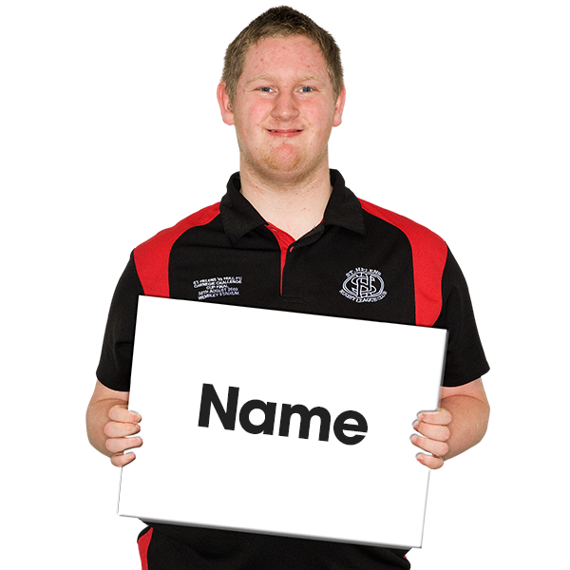
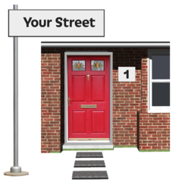
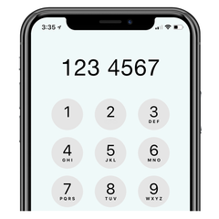

Name:
Address:
Phone Number:
E-mail:

