Slide 1


Inverclyde Community Choices
This is Inverclyde Council’s new digital platform for Community Engagement
This guide will help you access the platform and provide a brief overview of how to navigate the platform.
For more support please contact CLD.Admin@Inverclyde.gov.uk or Tel 01475 715450

Slide 2
How to Register
https://inverclyde.communitychoices.scot/

Slide 3
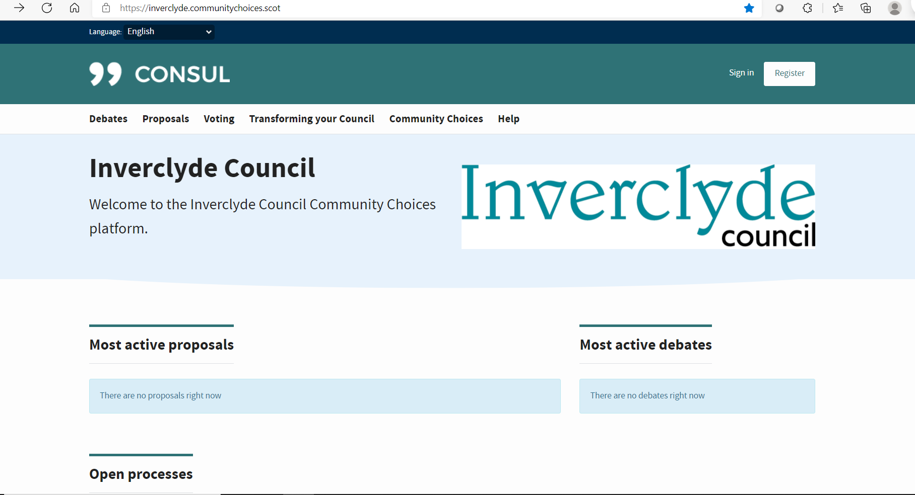
Register here

Slide 4
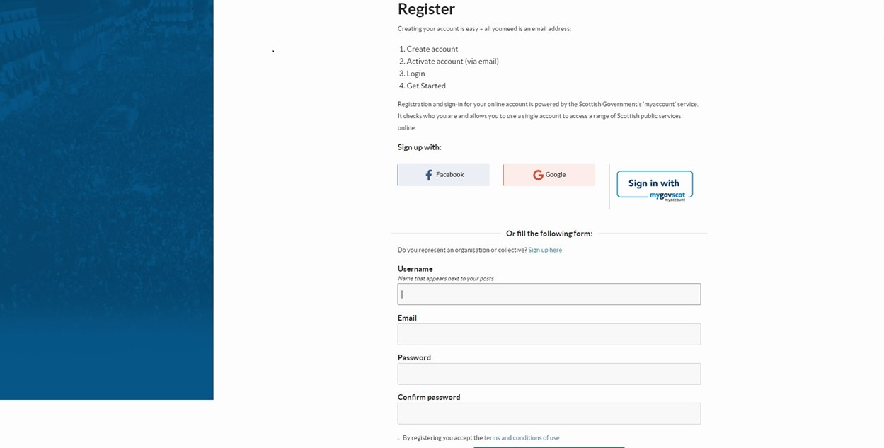
Select your preferred method of registration

Slide 5
How to register using the My Gov Scot option

Slide 6
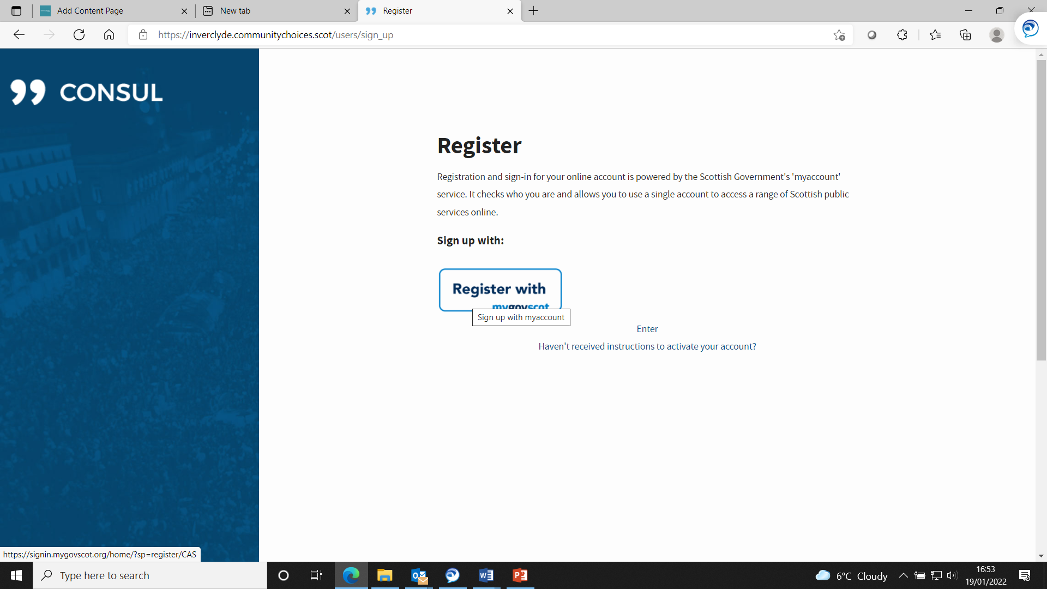
Register with My gov step 3
Click here to register

Slide 7
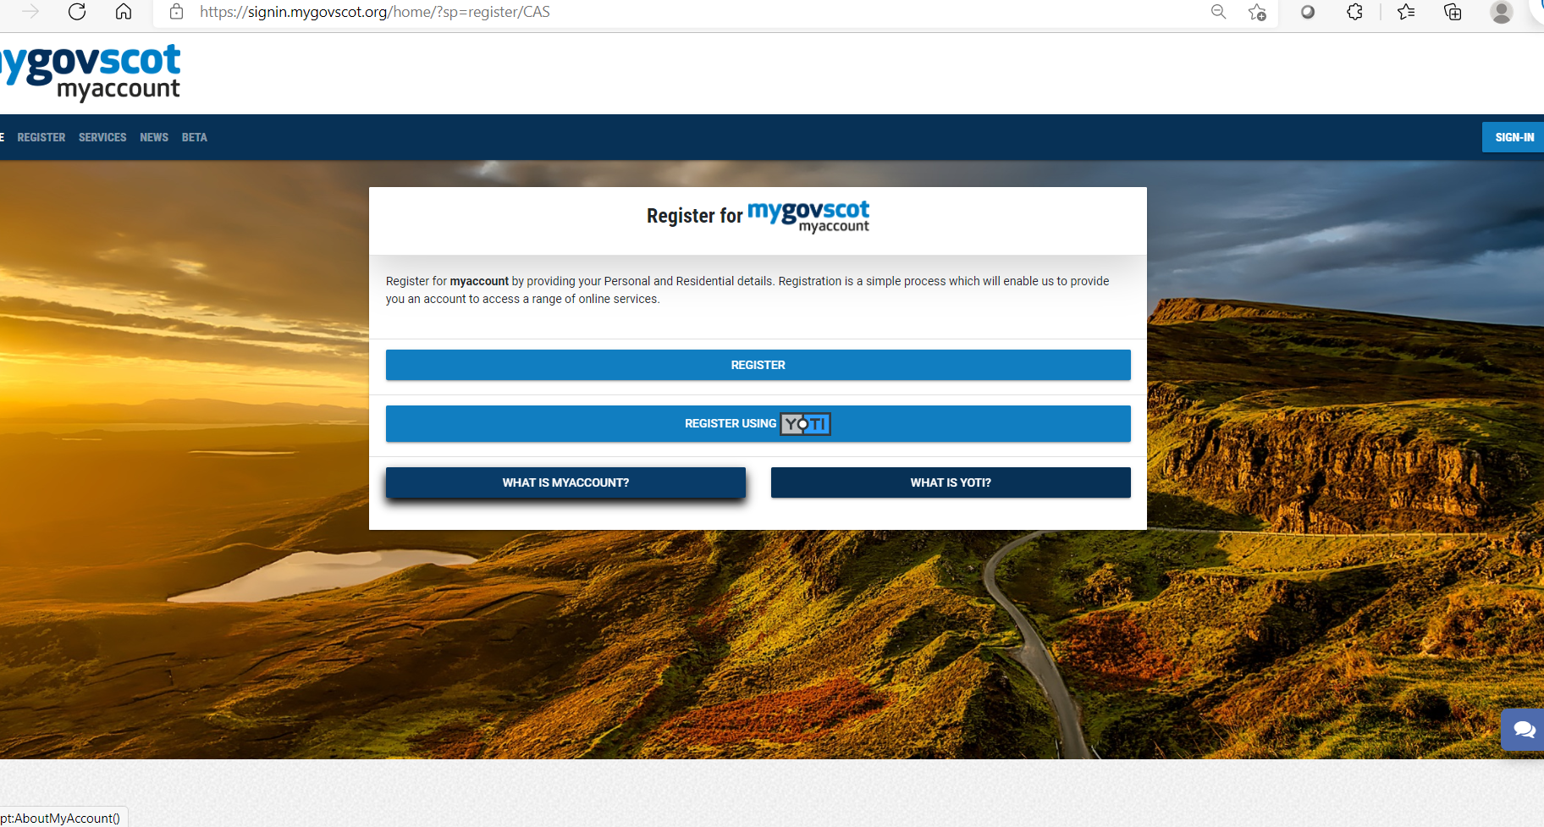
Register wit My Gov step 2
Click Register

Slide 8
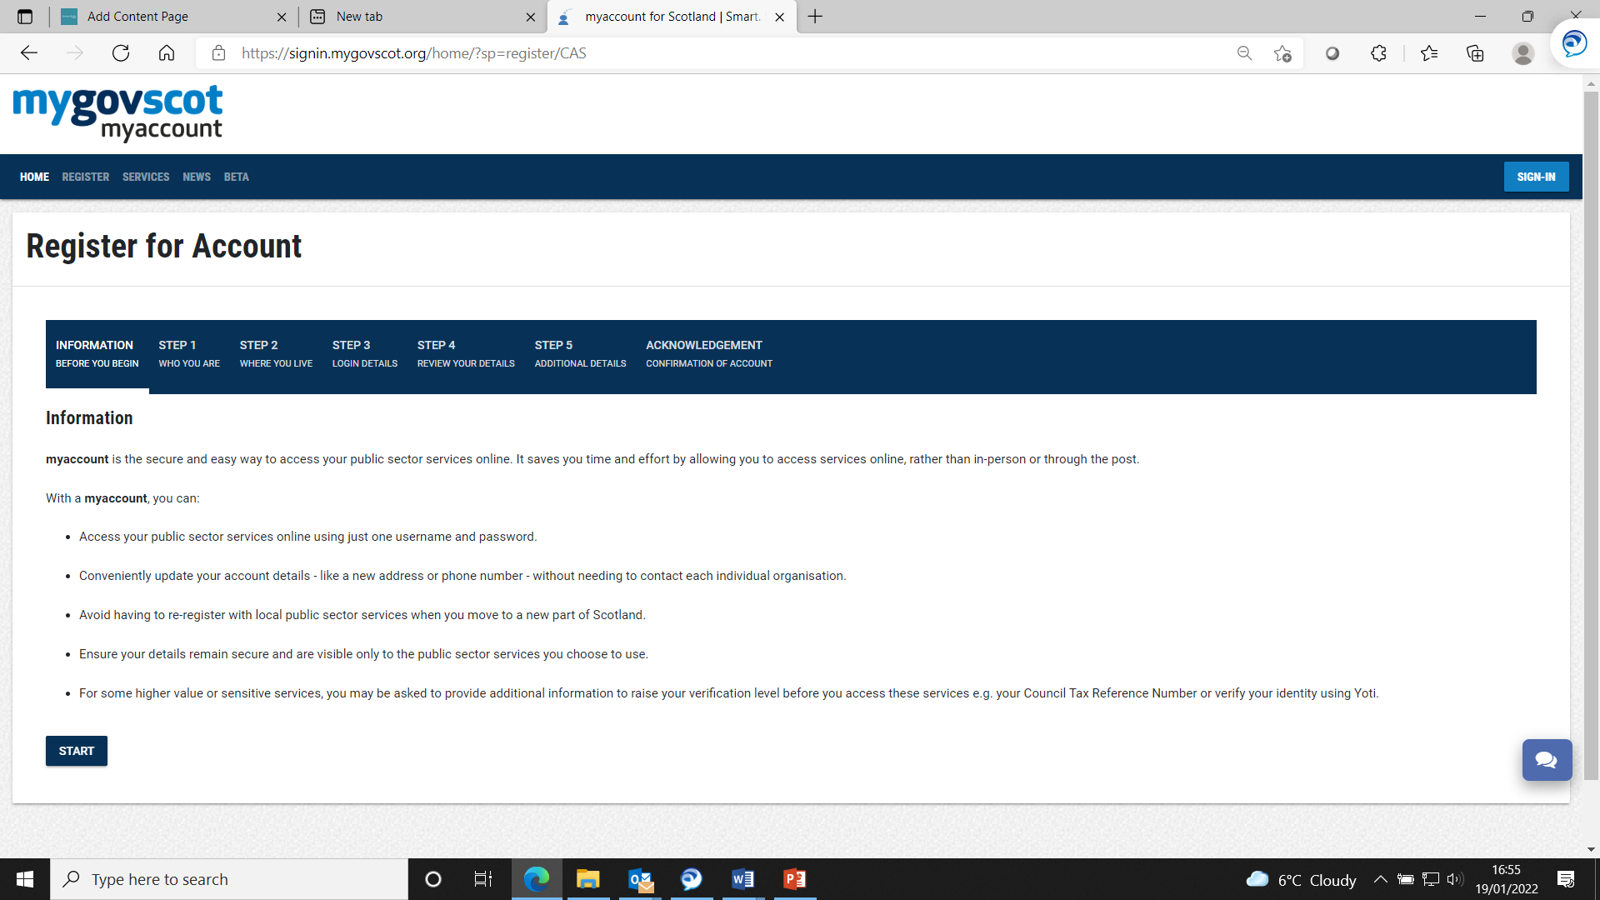
Follow the instructions, it will ask you at some stage if you want to use your email address as your username, click yes

Slide 9
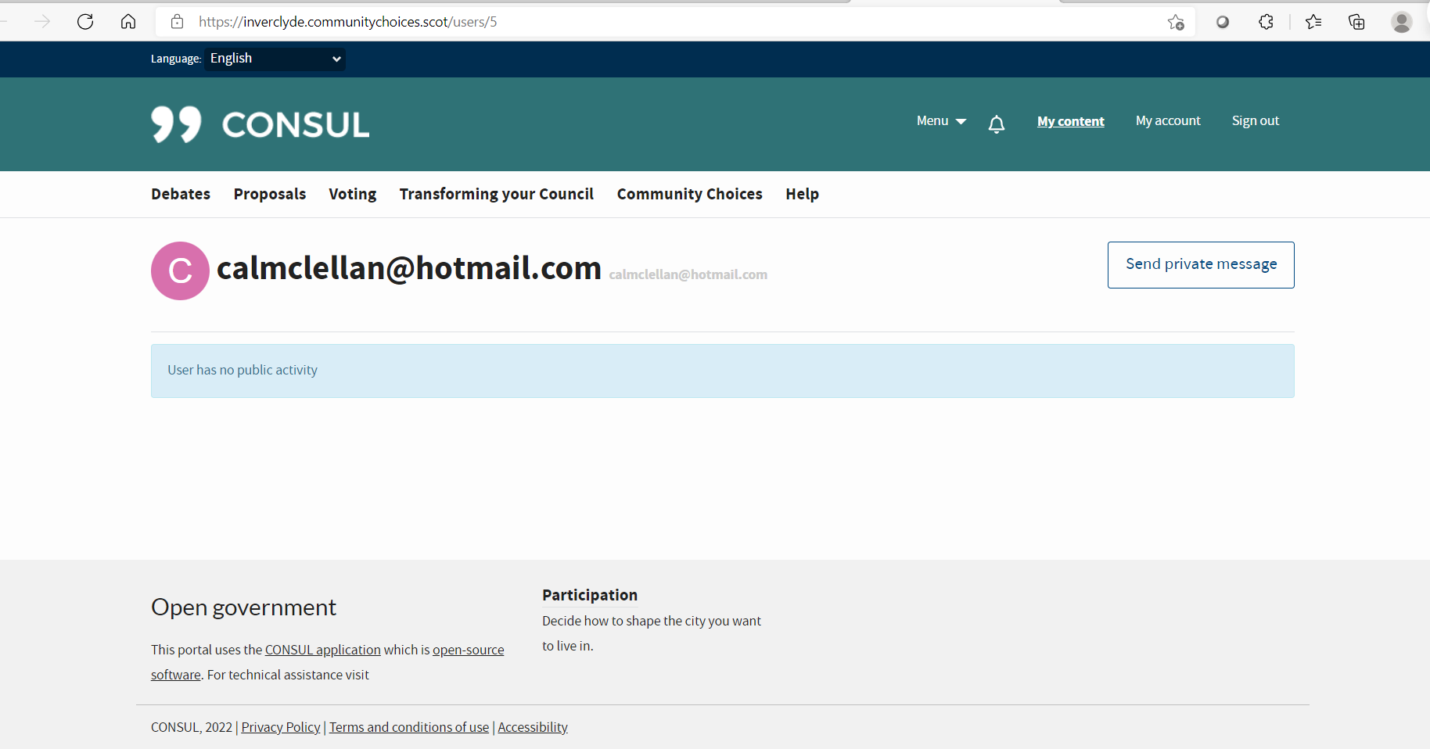
In terms of Data protection all we see is this

Slide 10
Taking Part in the Community Conversation

Slide 11
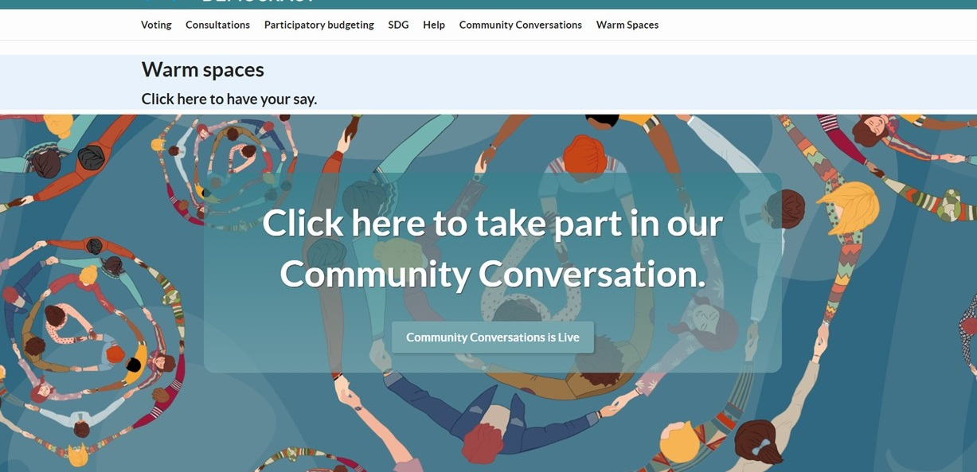
Once you are logged in you will see an option like the below example,

Slide 12
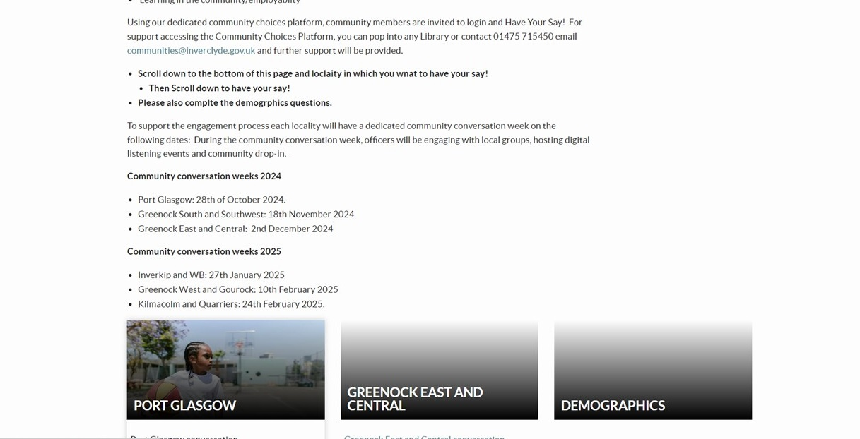
Read the provided information then scroll down and click on the locality you live in.

Slide 13
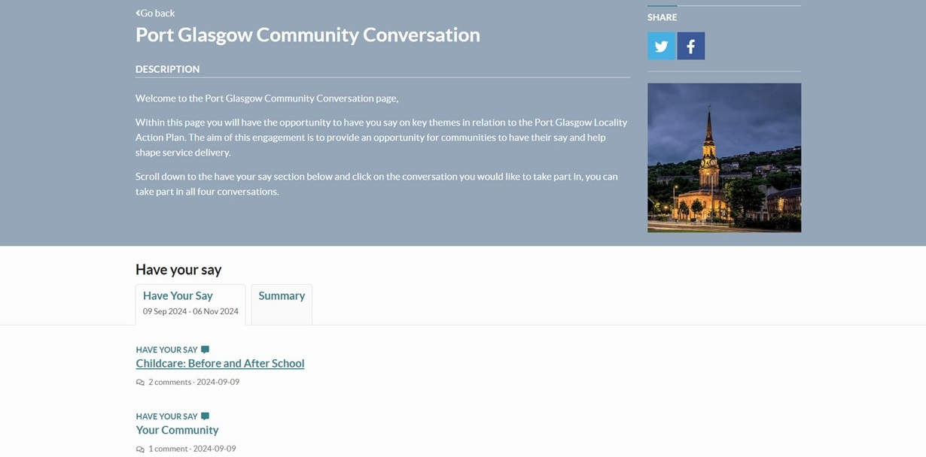
Read the provided information,
Scroll down to the have your say section
Select the conversation you wish to join.

Slide 14
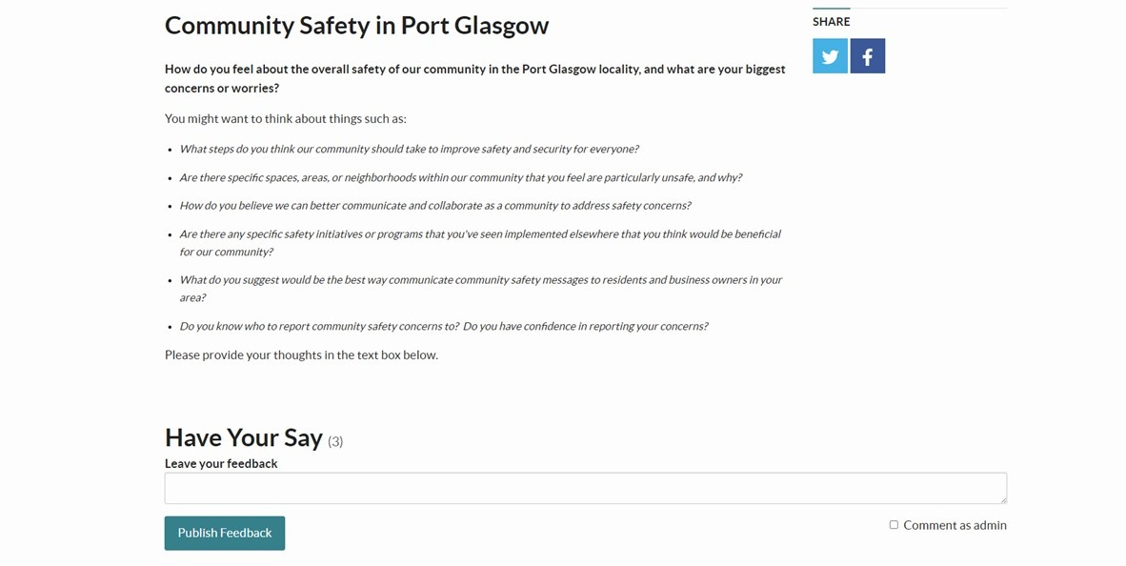
Read the provided information
Leave your feedback in the Have Your Say section
You can also reply and like/dislike other comments.
Repeat the same process to take part in the other conversations

