Slide 1

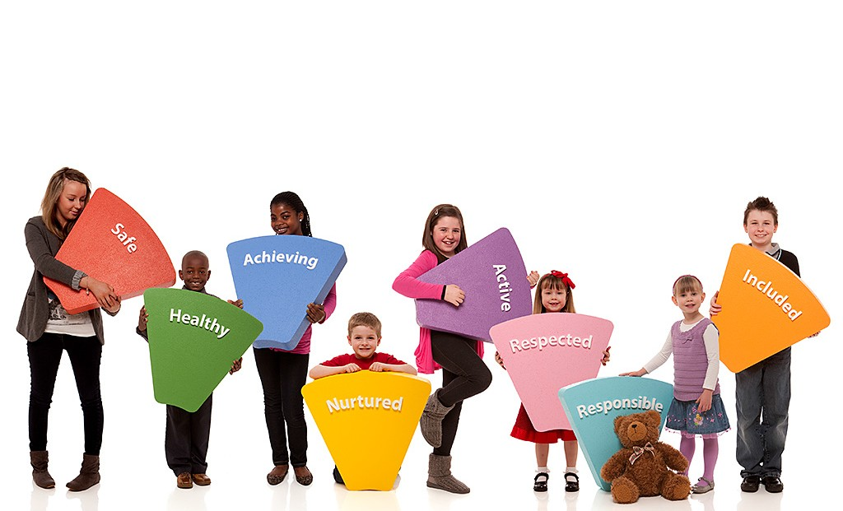
Wellbeing Assessment Training - Session 1
Single Agency - Education
Version Date: December 2015

Slide 2

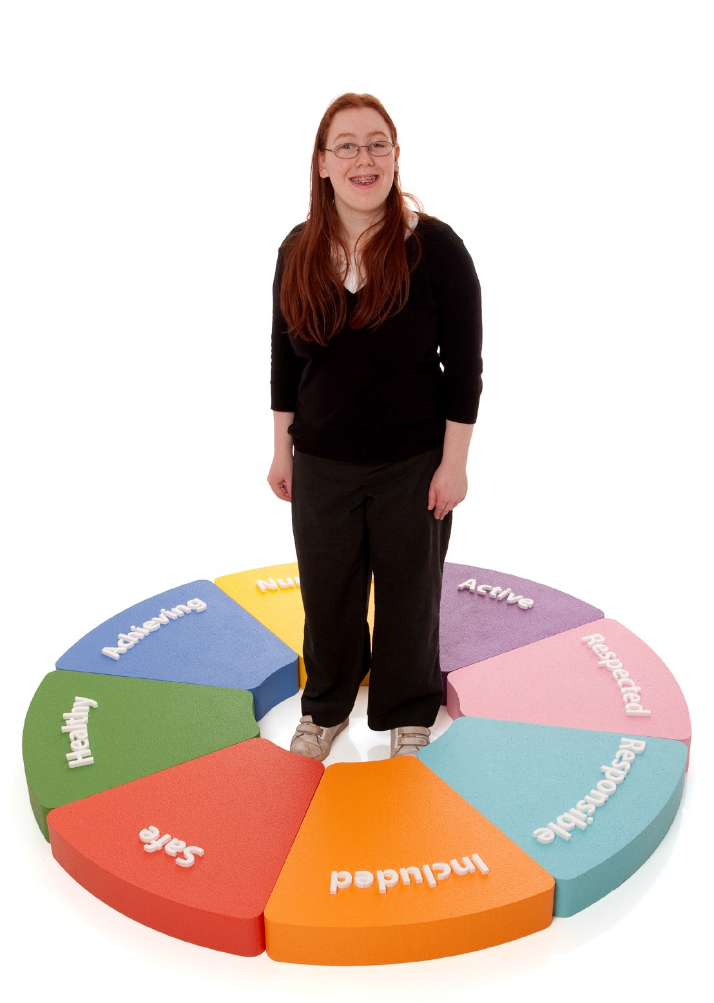
Overview
By the end of this training participants should be able to:
Understand and explain the national Getting it Right for Every Child Practice Model
Use information gathering, structuring, analysis, outcome planning and monitoring in all assessments and plans
Understand and appropriately use the Wellbeing Indicators
Understand and appropriately use the My World Assessment Triangle
Understand and appropriately use the Resilience Matrix

Slide 3
Learning Intentions (Session 1)
Participants will:
Have an overview of the key values underpinning the GIRFEC approach.
Understand the centrality of culture, systems and practice in ensuring the success of GIRFEC across the entirety of their establishment.
Undertake an overview of the National Practice Model with a specific focus on the Wellbeing Indicators.
Focus on the role of Observing and Recording
Know the 5 key questions that practitioners should ask before and during Wellbeing assessment.
Have a holistic understanding of the array of methods to gather assessment information that can lead into a Wellbeing Assessment.
Success Criteria (Session 1)
As a result of the training in this session, participants will have successfully conducted a high quality Wellbeing Assessment, focusing on the Wellbeing Indicators. This will be fed back at the start of session 2 in an anonymised fashion. .

Slide 4
Acknowledgements
Training materials and resources were adapted from :
North and South Lanarkshire Council
Angus Council
Highland Council
Greater Glasgow and Clyde Health Board

Slide 5
Introduction
Complete questionnaire individually
In small groups:
Discuss what you think are the key
values and principles underpinning the GIRFEC approach
Come to an agreement as a group on the
3 most important values
Notes:
Complete questionnaire (pre- questionnaire on knowledge and understanding of GIRFEC). This will provide a baseline measure and will be repeated at a later date to provide evidence of impact.
Group activity/discussion
As a group
- Discuss key values underpinning the GIRFEC approach
- e.g. promoting the wellbeing of children/YP; keeping children & YP safe
- Agree on 3 key values
- Take feedback on flipchart or express these in under 120 characters and tweet (if you are set up for tweets)

Slide 6
Moving away from...
Education
Social Work
Adult Services
Health
Notes:
Ask participants what they think the diagram represents?
Professionals working in silos independently - within their own culture, systems and practice approaches
The results of inspections and significant case reviews over the last two decades has shown that these differences can get in the way of helping children, young people and their families.

Slide 7
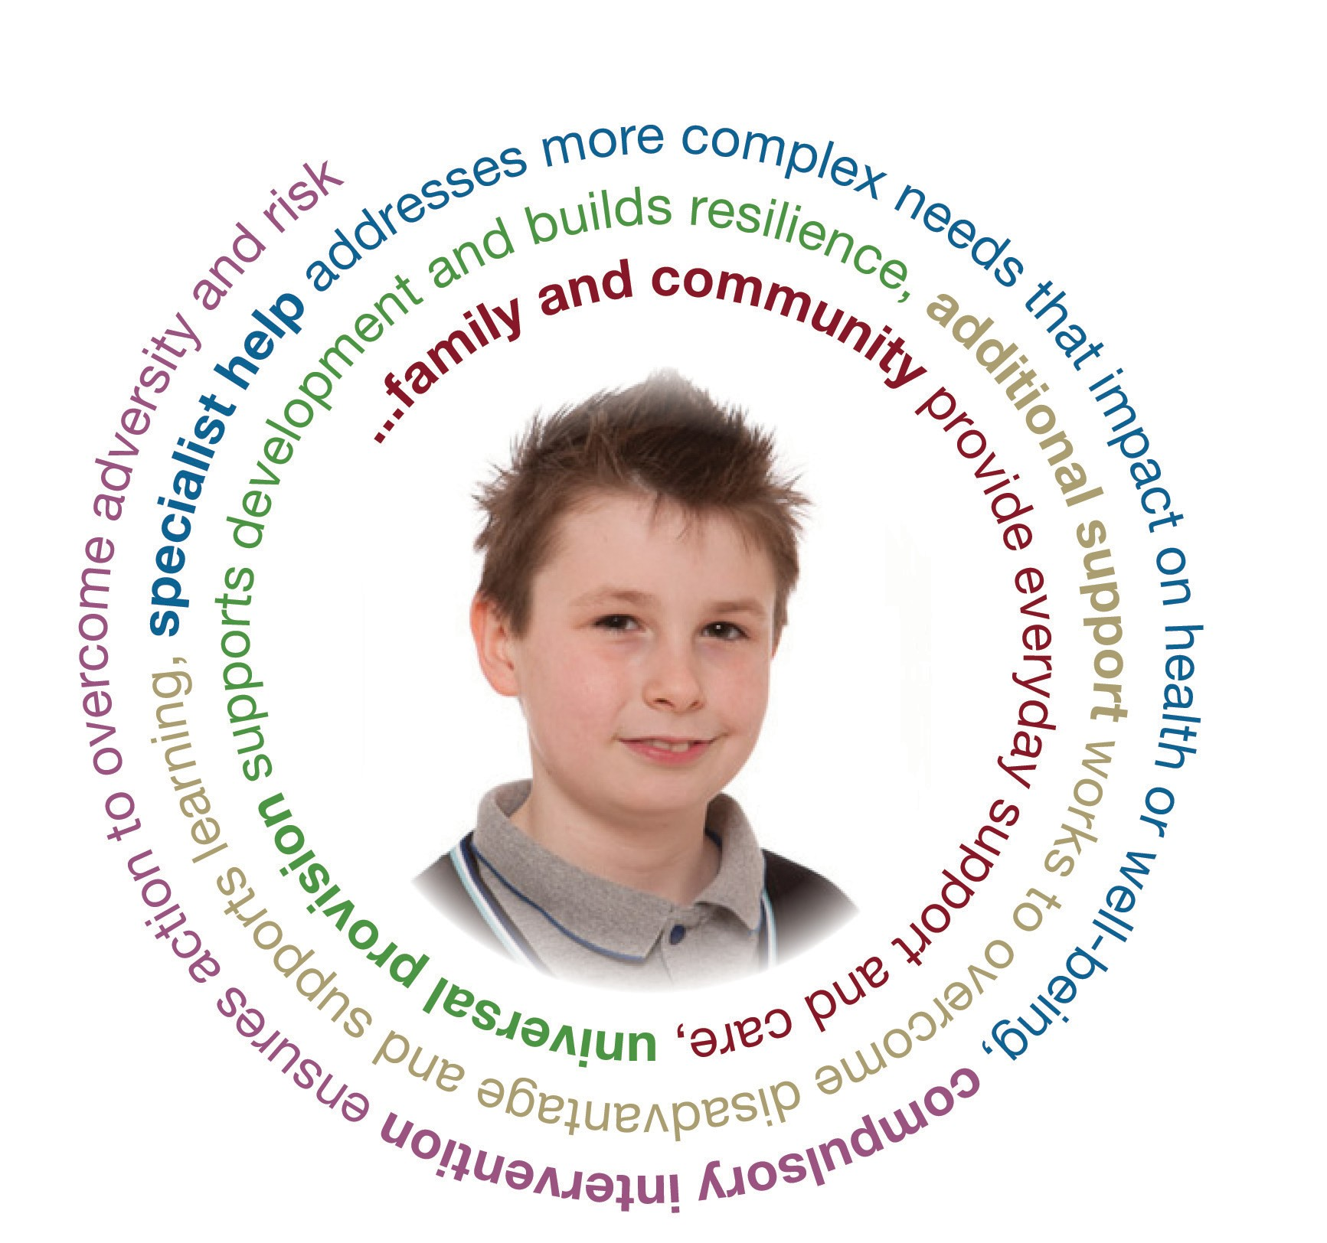
Moving towards...
Promoting the wellbeing of individual children and young people
Keeping children and young people safe
Putting the child at the centre
Taking a whole child approach
Building on strengths and promoting resilience
Providing opportunities to celebrate diversity
Providing additional help that is appropriate, proportionate and timely
Notes:
This slide represents where we are moving to.
With children and their individual needs placed firmly at the centre of everything that we do – how we think, how we act – in their best interests, to make sure they have the best possible future.
You might select a couple of areas to highlight.
Promoting the wellbeing of individual children and young people
This is based on understanding how children and young people develop in their families and communities, and addressing their needs at the earliest possible time.
Keeping children and young people safe
Emotional and physical wellbeing is fundamental and goes wider than child protection
Putting the child at the centre
Children and young people should have their views listened to and they should be involved in decisions that affect them
Taking a whole child approach
Recognising that what is going on in one part of a child or young person’s life can affect many other areas of their life and wellbeing
Building on strengths and promoting resilience
Using a child or young person’s existing networks and support where possible
Providing opportunities to celebrate diversity
Children and young people should feel valued in all circumstances and practitioners should create opportunities to celebrate diversity
Providing additional help that is appropriate, proportionate and timely
Providing help as early as possible and considering short and long-term wellbeing needs

Slide 8






How it fits together
Systems Change
Practice Change
Cultural Change
Notes:
Important to emphasise that this is more than just ‘what you do’….this requires a change in culture which changes the systems you have in place and the practices that you have in place.
Think about your own establishment – where are you in relation to each of these?
- Emphasise that each of these is dependent on the other…’culture’…’systems’…’practice’
Examples of culture, systems and practice:
Culture
To reinforce the core values of 'children at the centre' and 'families as partners'
Developing trust across professions and agencies
Creating a learning organisation
Systems
Develop a strategic approach to change
Testing and finding ways to overcome the obstacles – ‘tests of change’
GIRFEC pathway
Practice
To establish a Getting it Right for Every Child practice approach across Inverclyde
Increase levels of confidence and competence

Slide 9
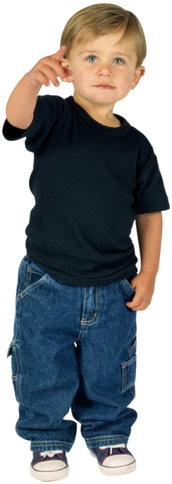
Agree/Disagree Activity
All people have strengths and capacities
People can change and grow through their strengths and capacities
People are experts in their own situation
The problem is the problem; the person is not the problem
Problems can prevent people from
noticing and appreciating their
strengths and capacity to find
their own solution
People have good intentions and
are doing the best they can
Notes:
Agree / Disagree Activity
Using the statements on the slide, ask participants to get on their feet.
Draw a line across the room with ‘agree’ on one side and ‘disagree’ on the other. ‘Not sure’ is in the middle.
Read out the statements on the slide one at a time and ask participants to place themselves where they think they are in relation to the statements.
Ask 1 or 2 people from each section to discuss what their thoughts are around the statement – why have they positioned themselves where they are?
These statement are the underlying principles of a strength based / solution oriented approach.

Slide 10
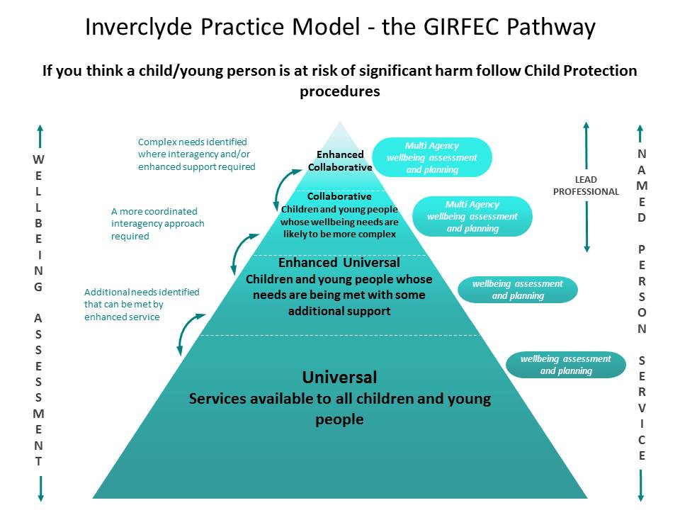
Notes:
This is the new Inverclyde GIRFEC Pathway. Wellbeing assessment is core to all elements of the pathway – from universal to enhanced collaborative.
The level and breadth of assessment will vary depending where a young person is on the pathway. A learner’s journey will vary over time.
This training is focussed on how education staff undertake wellbeing assessment at universal and enhanced universal levels.
There will be inter-agency training focussed on collaborative and enhanced collaborative levels.

Slide 11

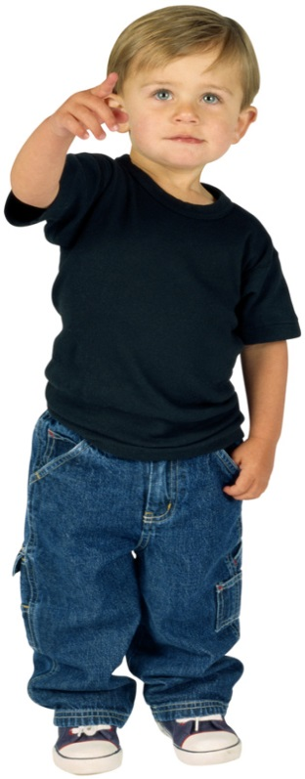
Wellbeing Assessment is …
Notes:
Ask group to consider what process they would go through to complete a wellbeing assessment.
e.g. gathering information, articulating outcomes
Collate responses on flipchart paper.
Answers on the next slide.

Slide 12
Wellbeing Assessment is …
Relationship building – developing trust and understanding between all relevant people
Seeking the views of all relevant parties – recording all available information (including the child and parent/carer)
Gathering information – record of what you have seen or heard
Structuring – organising under Wellbeing or My World Triangle Assessment
Analysis – a description of the impact of your findings on the child/young person
Articulating outcomes – a description of the positive change you would like to see or maintain for the child
Planning actions – what needs to happen to bring about the change
Reviewing progress – monitoring the changes positive or negative
Notes:
Read through the slide and feedback the core elements of a wellbeing assessment.

Slide 13
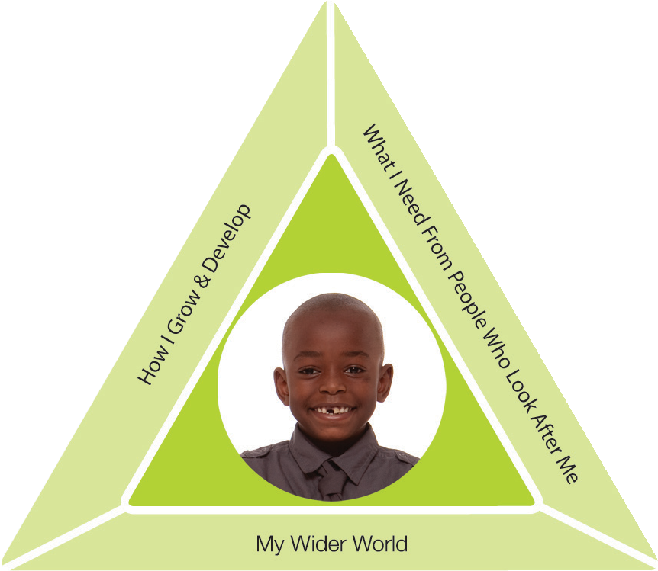
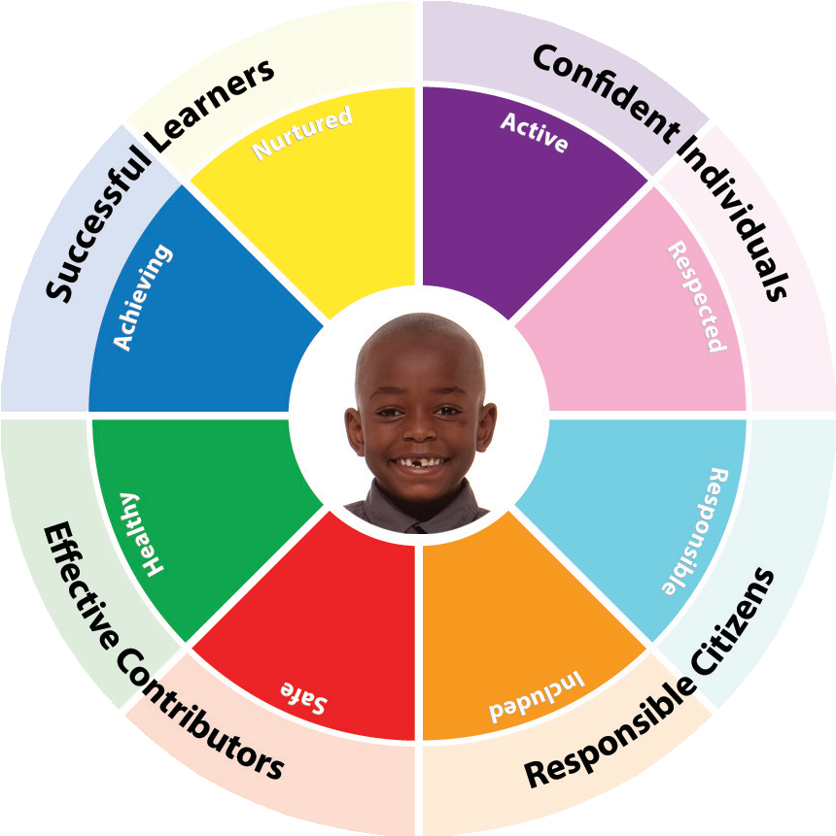
The National Practice Model
Wellbeing
Assessment
Appropiate, Proportionate, Timely
Wellbeing
Resilence
Adversity
Protective Environment
Vulnerability
Observing
& Recording
Gathering Information
& Analysis
Planning Action
& Review
Notes:
When assessment, planning and action are needed, practitioners can draw on the Getting it right for every child National Practice Model, which can be used in a single or multi-agency context, and:
provides a framework for practitioners and agencies to structure and analyse information consistently so as to understand a child or young person’s needs, the strengths and pressures on them, and consider what support they might need
defines needs and risks as two sides of the same coin. It promotes the participation of children, young people and their families in gathering information and making decisions as central to assessing, planning and taking action
provides a shared understanding of a child or young person’s needs by identifying concerns that may need to be addressed.
The National Practice Model is a dynamic and evolving process of assessment, analysis, action and review, and a way to identify outcomes and solutions for individual children or young people. It allows practitioners to meet the Getting it right for every child core values and principles in an appropriate, proportionate and timely way.
This training will focus on the 3 areas of :
observing & recording
Gathering Information and Analysis
Planning Action and Review

Slide 14

Observing and Recording
Notes:
The Wellbeing wheel helps us to move towards using wellbeing as the structure for organising what we know about a child/family.
Refer to description of wellbeing indicators in the Workbook p8-10 – Wellbeing Indicators and Wellbeing Indicator Prompts

Slide 15
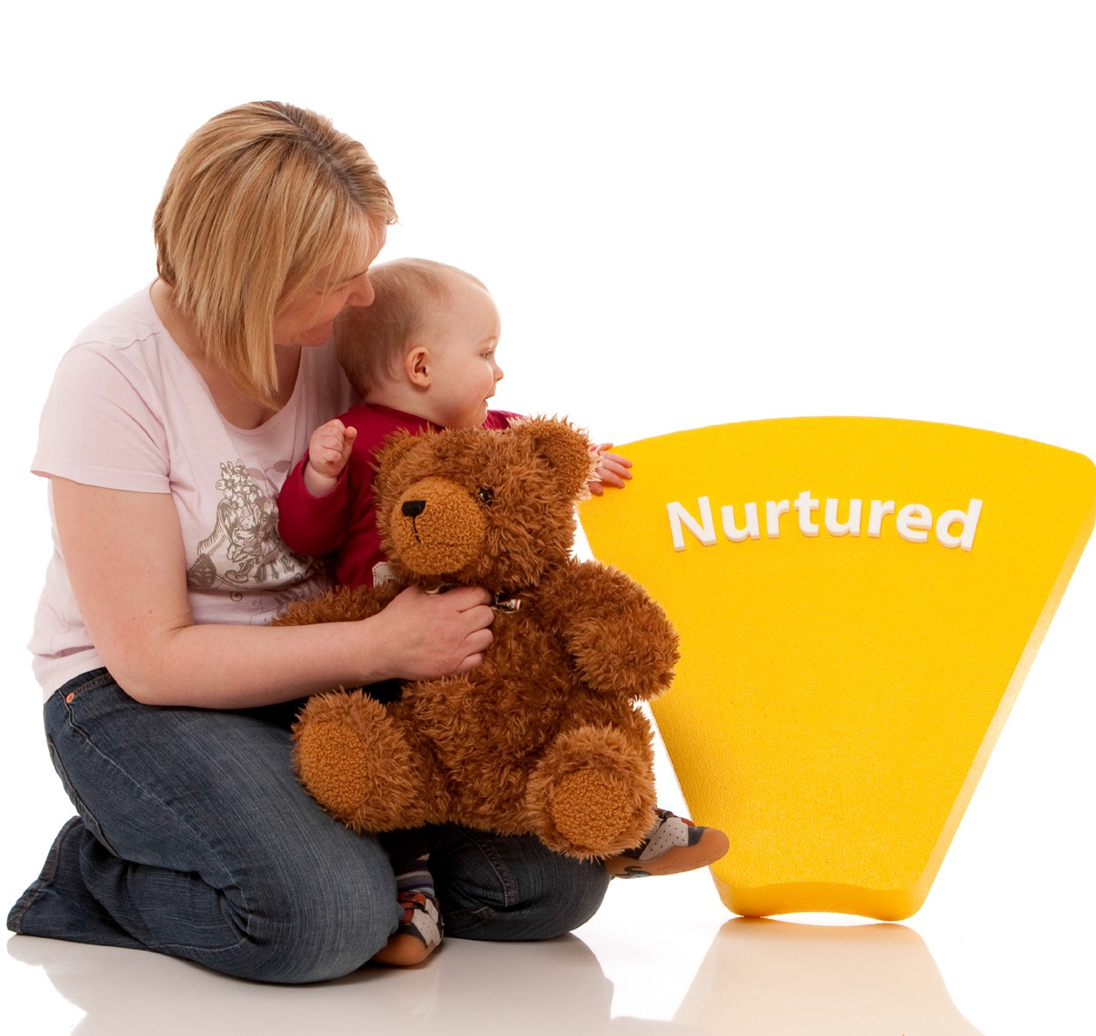
Observation and Recording
Share within your group how you observe and record wellbeing within the GIRFEC pathway within the first 2 levels:
Universal e.g. daily check-ins
Enhanced universal e.g. observation sheets
Record on flipchart paper
Notes:
Carousel activity in 4 groups of 5. 2 groups start with ‘universal’. Other 2 groups start with ‘enhanced universal’. Each group records on flipchart and swap to next group.
Examples:
Universal
Pupil wellbeing questionnaires
format for recording concerns at class level; general class information including social interactions; friendships; engagement with learning and play etc
Enhanced Universal
More focussed observation on a area of concern
Chronology; SEEMIS record; Wellbeing Assessment paperwork
Pupil voice; parent/carer voice
Pull activity together by taking feedback from groups.

Slide 16
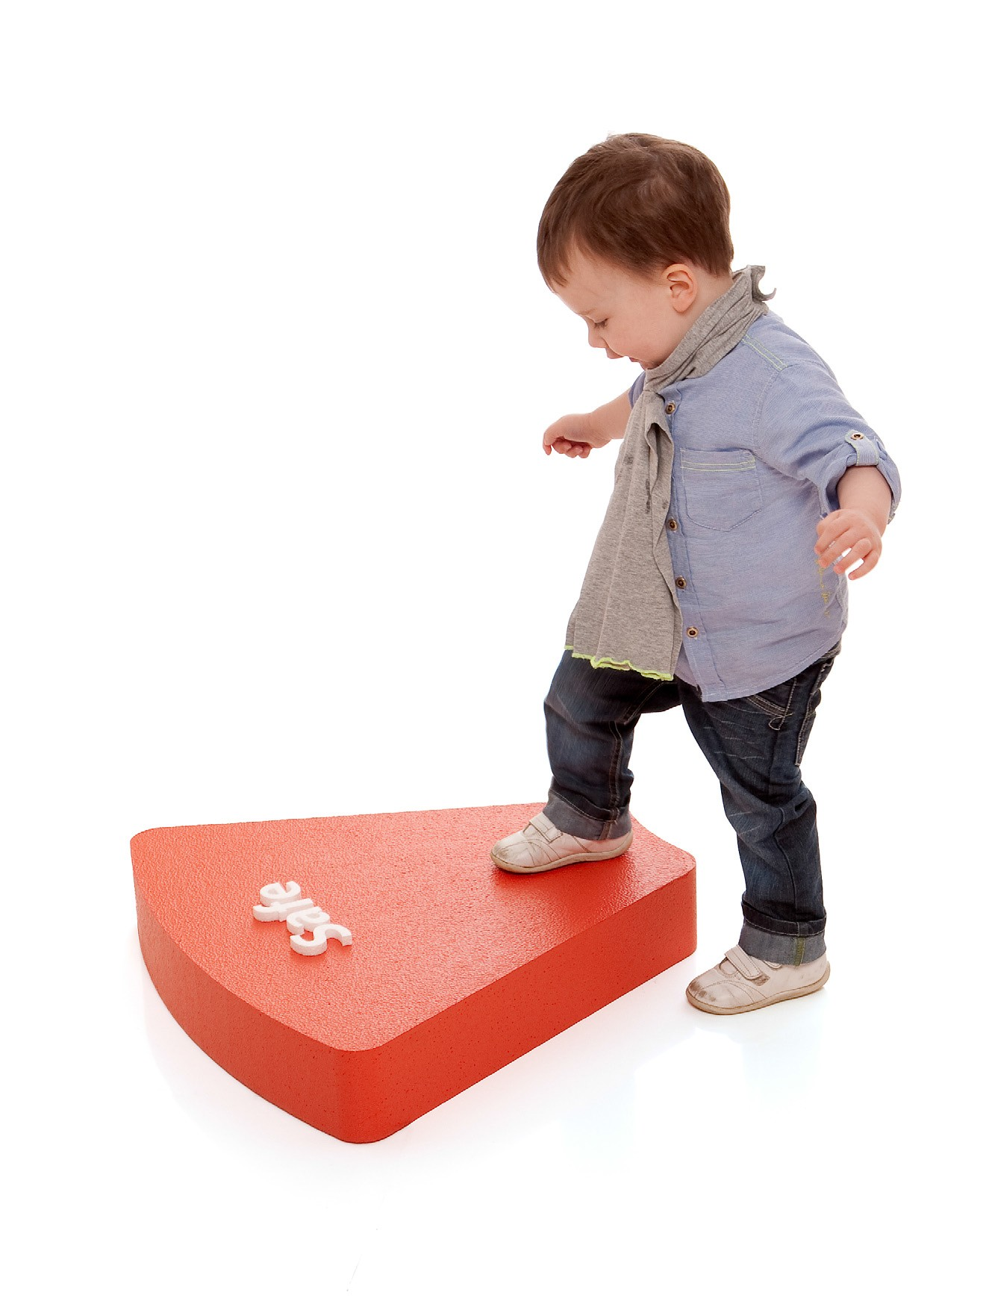
Questions for every practitioner
What is getting in the way of this child’s wellbeing?
Do I have all the information I need to help this child?
What can I do now to help this child?
What can my agency do to help this child?
5. What additional help, if any, may be needed from others?
Notes:
These are the key questions every agency/practitioner should be asking before and during a wellbeing assessment – even in the early stages (Universal and enhanced universal) of observing and recording.
This can help to pull together to pull your conclusions and recommendations on page 3 of the wellbeing assessment.

Slide 17
Gathering Wellbeing Assessment Information
Assessment information gathered from:
School staff
Child/young person voice
- ‘What I think’
- Wellbeing Web
- Nurturing Me
Parent/carer voice
- Wellbeing Web
Notes:
The bulk of the information gathered at this stage, will be the assessment information gathered from school staff – using the observations and methods for gathering and recording information from universal and enhanced universal which we have just discussed.
In pulling together all the conclusions and recommendations (page 3 wellbeing assessment) we need to gather assessment information from a variety of contexts including the voice of the child/yp and parent/carer
Take copies for each group of:
‘What I think’ tool for EYs, PS and Secondary
Wellbeing Web; children and young people prompts; parent/carer prompts
Nurturing Me
If you have time, ask groups to review one tool each and feedback to whole group.
Provide time for groups to look at other tools.

Slide 18
Activity – Wellbeing Assessment
Read the Wellbeing Assessment - Guidance Notes in your Book of Forms along with the Wellbeing Assessment Exemplar.
In 2s, use the Wellbeing
Assessment proforma and one
of the practice examples to
complete a wellbeing assessment
Notes:
Allow 20-30 minutes for this activity.
Make sure you have a large wellbeing wheel at the centre of each group.
The Wellbeing wheel helps us to move towards using wellbeing as the structure for organising what we know about a child/family.
Direct the group to their Book of forms– refer to the wellbeing assessment guidance notes and exemplars.
Note: ensure that you cover strengths/protective factors and developmental needs/challenges.

Slide 19
Task
For next session, choose a child or young person that you are working with. This may a child that is already at enhanced universal /collaborative within the GIRFEC pathway
Use the Wellbeing Assessment
proforma to complete a
wellbeing assessment.
Read the My World Triangle Assessment - Guidance Notes in your Book of Forms along with the My World Triangle Assessment Exemplar.
Notes:
Ask participants to be prepared to feedback at the next workshop:
What went well
What issues were challenging

Slide 20
Learning Intentions (Session 1)
Participants will:
Have an overview of the key values underpinning the GIRFEC approach.
Understand the centrality of culture, systems and practice in ensuring the success of GIRFEC across the entirety of their establishment.
Undertake an overview of the National Practice Model with a specific focus on the Wellbeing Indicators.
Focus on the role of Observing and Recording
Know the 5 key questions that practitioners should ask before and during Wellbeing assessment.
Have a holistic understanding of the array of methods to gather assessment information that can lead into a Wellbeing Assessment.
Success Criteria (Session 1)
As a result of the training in this session, participants will have successfully conducted a high quality Wellbeing Assessment, focusing on the Wellbeing Indicators. This will be fed back at the start of session 2.

Slide 21
Wellbeing Assessment Training – Session 2
Single Agency - Education

Slide 22
What we covered in Session 1
An overview of the Getting it Right for Every Child Practice Model
Using the GIRFEC Wellbeing Indicators as the structure for information gathering
Completed a wellbeing assessment

Slide 23
Learning Intentions (Session 2)
Participants will:
Have fed back on the Wellbeing Assessment task from Session 1
Understand that the move from using the Wellbeing Indicators to the use of the My World
Know the three component parts of the My World Triangle (i.e. How I Grow and Develop, What I Need from People who Look after Me and How I Grow & Develop)
Have analysed assessment information and developed outcomes.
Success Criteria (Session 2)
Participants will have successfully completed an assessment, based on the My World Triangle, and be ready to feed back on this in Session 3 in an anonymised fashion.

Slide 24
Feedback - Homework
In groups, discuss the wellbeing assessment that you have completed since the last session.
Use the flipchart paper for feedback to the larger group.
Notes:
Activity in small groups:
Participants share the wellbeing assessment they have completed since last session. Remember to ensure confidentiality we ask that participants don’t discuss the detail (names etc) of the young person for whom they have completed the wellbeing assessment.
Discuss using the following headings: (on Flipchart at each group)
In undertaking the wellbeing assessment:
- What went well ?
- Any challenges/difficulties? If so, how did you overcome these?
- What else do you need to know?

Slide 25
Focus for Session 2
To use the My World Assessment Triangle as a framework for gathering and analysing information

Slide 26
The National Practice Model
Wellbeing
Assessment
Appropiate, Proportionate, Timely
Wellbeing
Resilence
Adversity
Protective Environment
Vulnerability
Observing
& Recording
Gathering Information
& Analysis
Planning Action
& Review
Notes:
Remind participants of the GIRFEC National Practice Model (briefly).

Slide 27
Activity
Think of a case example where you might undertake a wellbeing assessment using the My World Triangle. Remember to consider whether it is appropriate and proportionate
E.g.
Child/young person who is experiencing difficulties at home which is impacting on their engagement in school
Child/young person who has experienced bereavement or loss that is impacting significantly on his/her ability to cope both at home and in school.
Notes:
Ask participants to have a discussion in their group (about 5-10 mins).
Ask each group to come up a few brief examples. Your examples should reflect case studies where the:
Level of concern is increasing. Information needing to be gathered from the wider context.
Consideration of moving towards collaborative working.
Remember to ensure confidentiality we ask that participants don’t discuss the detail (names etc) of the young person they have in mind.
Take feedback as a whole group.

Slide 28
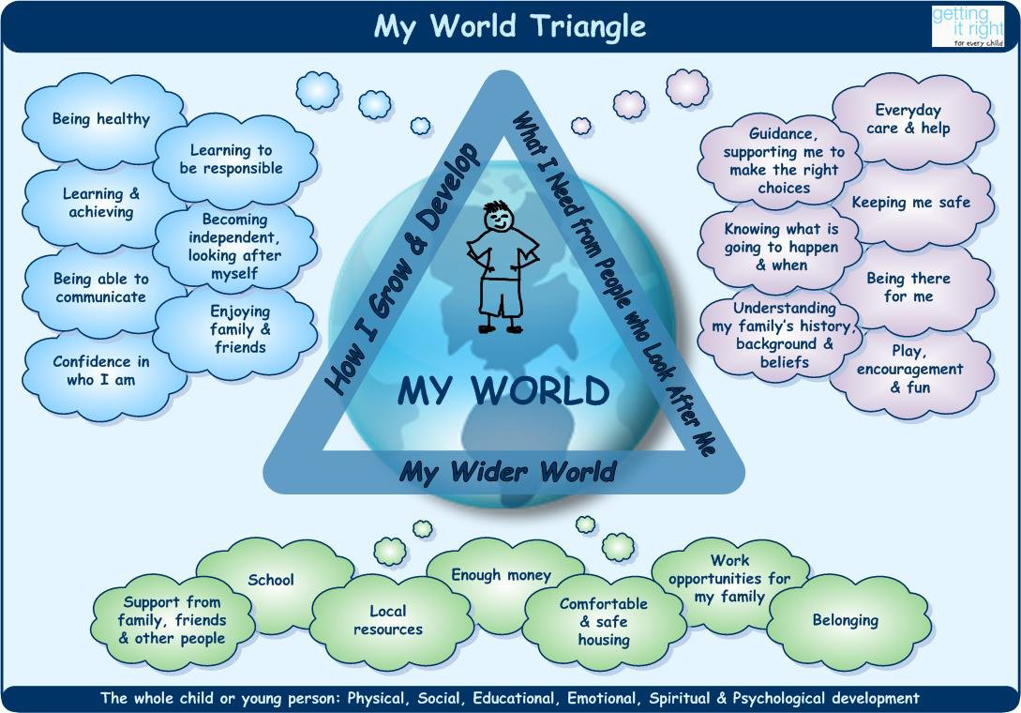
Notes:
Remind participants that this is part of the GIRFEC National Practice Model. We will focus on this at todays workshop.
The next three slides describe this in more detail.
The purpose of the My World Triangle is to provide a visual map to help practitioners, children and families think about what is happening in a child’s whole world and the likely impact on their wellbeing and development
Some of the information will be routinely gathered by practitioners in universal services eg a health visitor will measure whether a child is reaching developmental milestones, a teacher will monitor attendance, development and educational progress and be aware of a child’s relationships with their peers.
When using the My World Triangle consider the following questions in relation to each:
What information have I got?
Is this enough to assess the child’s needs and make a plan?
If not, what extra information do I need?
Where/who will I get that from?

Slide 29
My World Triangle – How I grow and develop
Being healthy
Learning and achieving
Being able to communicate
Confidence in who I am
Learning to be responsible
Becoming independent and looking after myself
Enjoying family and friends
Notes:
This helps to organise the information that you have. You may not always have all the information for all areas, and may need to involve partners.
How I grow and develop This dimension captures evidence of the child’s wellbeing in relation to their physical, cognitive, social and psychological development
Going over each of the seven domains within each dimension of the triangle, encourage participants to offer what is already known from wellbeing
Under how I grow and develop
Being healthy = healthy.
Learning and achieving = achieving.
Being able to communicate = Respect
Learning to be responsible and becoming independent and looking after myself = responsible
Enjoying family and friends = included.
Confidence in who I am is a new field and has to be explored. Children can be confident in their safety, confident learners, confident to express emotions, confident communicators and confident role models so this field cuts across most of the indicators and requires to be considered in detail.

Slide 30
My World Triangle – What I need from people who look after me
Guidance supporting me to make the right choices
Knowing what’s going to happen and when
Understanding my family’s history, background and beliefs
Everyday care and help
Keeping me safe
Being there for me
Play encouragement
Notes:
What I need from the people who look after me - Go over the 7 domains on the slide.

Slide 31
My World Triangle – My Wider World
School 5. Comfortable and safe housing
Support from family and 6. Work opportunities for my
friends family
Local resources 7. Belonging
Enough money
Notes:
Under My Wider World we need to add more detail about finances, employment and community resources as this information may not have been gathered.
As education staff you may not have this information so need to know who to go to to get it – ensuring it is relevant and proportionate to the issues in hand.

Slide 32
My World Triangle
Being healthy
Learning and achieving
Being able to communicate
Confidence in who I am
Learning to be responsible
Becoming independent and looking after myself
Enjoying family and friends
Guidance supporting me to make the right choices
Knowing what’s going to happen and when
Understanding my family’s history, background and beliefs
Everyday care and help
Keeping me safe
Being there for me
Play encouragement
School 5. Comfortable and safe housing
Support from family and friends 6. Work opportunities for my family
3.Local resources 7. Belonging
4. Enough money
Notes:
Show this slide to summarise how this fits together as a whole.
Sometimes specialist information is required e.g. Paediatric report and needs to be requested (Request for Assistance)
This should be completed in collaboration with the parent/carer and child/young person.
Note: Consultation and involvement of Parent/carer throughout the process is vital. As are the views of the child/young person.

Slide 33
Activity - Wellbeing Assessment
In groups, use the practice example and the Wellbeing Triangle Assessment proforma to structure information within the My World Triangle.
Use:
green post-its to write on any strength based information
Pink post-its for any needs / pressures
yellow post-its for any information you still
need to complete your assessment.
Notes:
Refer to Workbook; Practice Examples (p24-29) . Select one of the practice examples.
Refer to Wellbeing Triangle Assessment (Guidance and Exemplar) in Book of Forms
Each group will have a large Wellbeing Triangle in the centre of their group.
Use:
green post-its to write on any strength based information (strengths/ protective factors)
Place the post-its on the most relevant domain/side of the triangle.
Pink post-its for any needs / pressures
As above, place the post-its on the most relevant domain/side of the triangle.
yellow post-its for any information you still need to complete your assessment.
Consider where you could access this information
Allocate around 20 mins for this activity.

Slide 34

How do we make sense of this information ?
Notes:
This is a key stage in wellbeing assessment. Having gathered all your assessment information from different sources, including some complex information, how do we make sense of it?

Slide 35
What is Analysis?
Analysis must:
Clarify the balance between the strengths and pressures in the child/young person’s life
Appraise all of the information past and present
Evaluate the impact of the child/young person’s situation on their wellbeing
Articulate the immediate or emerging risks to the child/young person
Establish what needs to change
Highlight any differences in understanding or views about the child’s situation and what needs to change
Notes:
Now remind participants that analysis is a crucial part of the assessment process.
It’s important to emphasise that many professionals are better at gathering information than analysing and good assessment must provide not only a summary of what is observed or information gathered but a robust appraisal of the impact on the child or young person.
This is a summary to help participants remember what analysis involves.
Ask yourself : So what does this tell us about the child/young person?

Slide 36
What is an outcome?
An outcome means … the effect or consequence of help received
Specific to each of the wellbeing indicators – it is not necessary to identify one or more outcomes under each wellbeing indicator, it is a question of identifying what needs to change then using wellbeing as the structure
Specific to the difficulties identified in assessment – if a difficulty is identified as lack of physical and emotional safety within the home, then there should be a related outcome such as improved physical and emotional safety in the home
Specific to the individual child/young person - a child’s outcome is specific to them rather than the adults who care for them. For example, the desired outcome under nurture, may be improved attachment to the baby’s primary carer whilst the action could be to improve the mother’s mental health
Specify whether short, medium or long term outcome
Notes:
This is also a crucial element of Wellbeing Assessment.
Refer to the Workbook (p.21-23) – Signpost group to ‘Writing SMART Outcomes / Exemplar for Sam’.
We will be focussing on writing outcomes next session – this is what the whole assessment process is leading towards.

Slide 37
Activity –
My World Triangle Assessment
In 2s, use the My World Triangle
Assessment proforma and the
practice example to complete
the proforma.
Notes:
Allow 20 minutes
Refer to the book of forms - My World Triangle Assessment

Slide 38

Homework Task
Select a child you have been working with recently and whom you know fairly well.
Before the next session complete a My World Triangle assessment for this child and record it on the My World Assessment proforma provided in your pack.
Be prepared to discuss this at the
next session.

Slide 39
Learning Intentions (Session 2)
Participants will:
Have fed back on the Wellbeing Assessment task from Session 1
Understand that the move from using the Wellbeing Indicators to the use of the My World
Know the three component parts of the My World Triangle (i.e. How I Grow and Develop, What I Need from People who Look after Me and How I Grow & Develop)
Have analysed assessment information and turned this into outcomes.
Success Criteria (Session 2)
Participants will have successfully completed an assessment, based on the My World Triangle, and be ready to feed back on this in Session 3 in an anonymised fashion.

Slide 40
Wellbeing Assessment Training – Session 3
Single Agency - Education

Slide 41
What we covered in Sessions 1 & 2
An overview of:
The Getting it Right for Every Child Practice Model
Using the GIRFEC Wellbeing Indicators for information gathering
To use the My World Assessment Triangle as a framework for gathering and analysing information

Slide 42
Learning Intentions (Session 3)
Participants will:
Have shared their use of the My World Triangle with peers.
Understand the Resilience Matrix and where this fits with the other component parts of the National Practice Model.
Success Criteria (Session 3)
Success will have been achieved when staff have drafted a plan to embed Wellbeing Assessment, involving the three component parts of the National practice Model, into the workings of their establishment.

Slide 43
Feedback - Homework
In groups, discuss the My World Triangle wellbeing assessment that you have completed since the last session.
Use the flipchart paper for feedback to the larger group.
Notes:
Activity in small groups:
Participants share the My World Triangle wellbeing assessment they have completed since last session.
Remember to ensure confidentiality we ask that participants don’t discuss the detail (names etc) of the young person for whom they have completed the wellbeing assessment.
Discuss using the following headings: (on Flipchart at each group)
In undertaking the wellbeing assessment
- What went well ?
- Any challenges/difficulties? If so, how did you overcome these?
- What else do you need to know?

Slide 44
The National Practice Model
Wellbeing
Assessment
Appropiate, Proportionate, Timely
Wellbeing
Resilence
Adversity
Protective Environment
Vulnerability
Observing
& Recording
Gathering Information
& Analysis
Planning Action
& Review
Notes:
Remind participants of the GIRFEC National Practice Model (briefly).
We will now take time to look at the Resiliency Matrix.

Slide 45
Resiliency Matrix for Analysing Information
Resilience
Normal development under difficult conditions e.g. secure attachment, outgoing temperament, sociability, problem solving skills
Adversity
Life events or circumstances posing a threat to healthy development e.g. loss, abuse, neglect
Protective Environment
Factors in the child’s environment acting as buffer to the negative effects of adverse experience
Vulnerability
Those characteristics of a child, their family circle and wider community which might threaten or challenge healthy development e.g. disability, racism, lack of or poor attachment
Daniel, B. and Wassell, S. (2002)
Assessing and Promoting Resilience in Vulnerable Children
Notes:
This would only be completed in exceptional cases which require a high level of interagency working and analysis
Once the My world Triangle Assessment has been completed, the resiliency matrix can be used for further analysis of the information. This would not be routinely completed but will most likely be used for more complex cases involving a number of inter-related factors.
Strengths and pressures are identified from gathering information using the My World Triangle and grouped within the 4 headings of resilience, vulnerability, protective environment and adversity.
Information is then weighted/plotted across the axis and it becomes clear what quadrant the child is in.
Quadrants :
Resilient child, protective environment
Resilient child, high adversity
Vulnerable child, protective environment
Vulnerable child, high adversity
Professional judgement is required and consideration given to factors which are most important, looking at the interaction between factors.
It will then be possible to see what needs to be done to help the child and family in order to strengthen protective factors and resilience and reduce adversity and vulnerabilities
Outcomes for the child then need to be considered against the 8 wellbeing indicators: safe, healthy, achieving, nurtured, active, responsible respected and included.
It will be useful to revisit the Resiliency Matrix in reviewing the child’s progress.

Slide 46
Activity - Resiliency Matrix
In 2’s,complete the Resiliency Matrix for your case study example.
Use the Resiliency Guide to help with this
Five Key Questions
Notes:
Allocate 30-45 minutes for this task
Refer to the Practice Examples in the workbook.
Groups should use the example that they have used for the My World Assessment.
Refer to the Workbook (p 11-19).

Slide 47
Learning Intentions (Session 3)
Participants will:
Have shared their use of the My World Triangle with peers.
Understand the Resilience Matrix and where this fits with the other component parts of the National Practice Model.
Success Criteria (Session 3)
Success will have been achieved when staff have drafted a plan to embed Wellbeing Assessment, involving the three component parts of the National practice Model, into the workings of their establishment.

Slide 48
What next …?
Discuss in your group how you plan to take this forward in your establishment.
Notes:
Ask participants to go into establishment groups.
Using Planning framework. Groups record for each establishment
What who When

