Slide 1
Named Person training for education services in Inverclyde

Slide 2




Named Person Training for Education Services
Programme
9.15am Welcome- overview
9.25am GIRFEC Inverclyde GLOW Site
9.35am GIRFEC and HSCP(multi-agency training)
9.45am GIRFEC Pathways – principles and definitions
      Transitions from Staged Assessment to GIRFEC Pathways
      Workshop
10.45am Tea/coffee
11.00am Workshop continued - Q&A opportunity
11.40am The Named Person service practice Education draft guidance

Slide 3
CYP (Scotland) Act 2014
Key Principles of GIRFEC
  Child-focussed approach
  A wellbeing approach
    Multi-dimensional, factors impacting on one another
  A preventative approach
  A joined-up approach
Wellbeing
  “The Act requires the promotion, support and safeguarding of wellbeing as a common approach across all across services engaging with children and families.”

Slide 4
OECD report on
Scottish Education
(Some) Conclusions:
  Inequality is deeply ingrained
  Engaging with families is crucial where needs are complex or multi-agencies are involved
  Overall Scottish Education exhibits many characteristics of success. In International comparisons Scotland is above OECD average in reading and science and similar to that in maths
  Teacher Education is a key to support CfE reforms
  Children require a clear pathway through whole school career
  CfE is not yet embedded

Slide 5

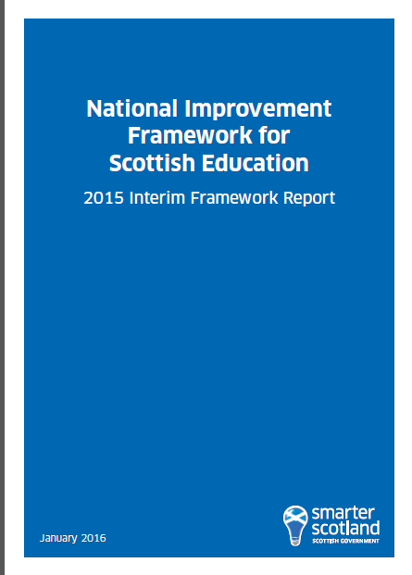


National Developments

Slide 6
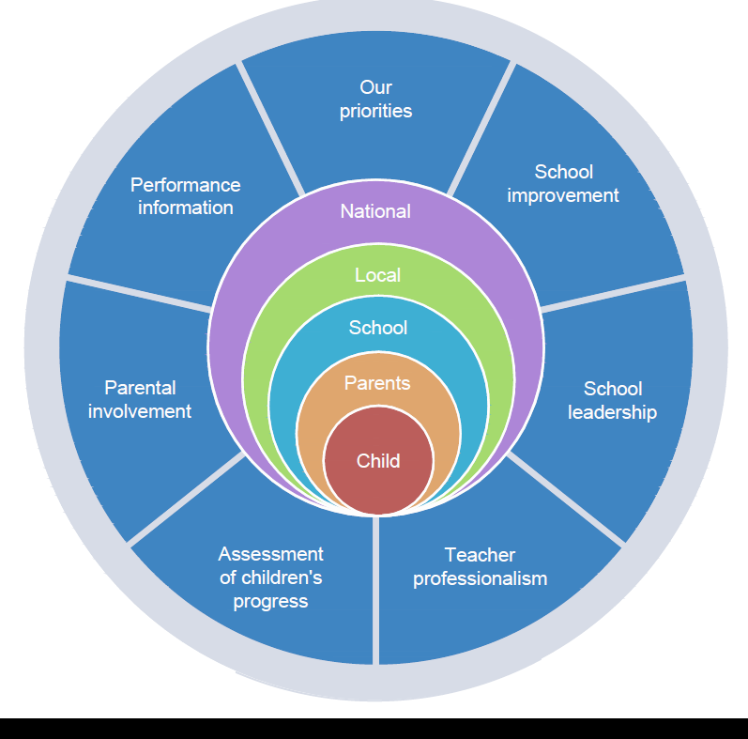
National Improvement Framework
Our Priorities
Improvement in attainment, particularly in literacy and numeracy
Closing the attainment gap between the most and least disadvantaged children
Improvement in children and young people’s health and wellbeing
Improvement in employability skills and sustained school leaver destinations for all young people
Notes:
The 6 key drivers for improvement will be instrumental to achieving our key priorities ,
The key priorities are:
Improvement in attainment, specifically in reading, writing and numeracy
Closing the attainment gap between the most and least disadvantaged children
Improvement in children and young people’s health and wellbeing
Improvement in school leaver destinations
The priorities may change over time depending on what our intelligence and evidence is telling us.

Slide 7
Named Persons in Inverclyde
CHILD’S AGE | NAMED PERSON | TIMESCALE OF RESPONSIBILITY | COMMENT
Birth to Primary School entry to P1 | Health Visitor | From birth until first day at primary school | Named person function only formally comes into play at birth; however midwives have a key role to play.
Primary School P1- P7 | Head Teacher or designated other such as Depute Head Teacher or Principal Teacher as appropriate | From first day at P1 until first day at secondary
Secondary School until 18th birthday | Head Teacher; Depute Head Teacher, Pupil Support or Guidance Teacher as appropriate | From first day at S1 until leaving school
Children or young people who leave school before 18th birthday | Opportunities for All team member, as appropriate | From date of leaving school until their 18th birthday
School age children or young people who are educated at home | Local Authority identified officer (senior education officer) | The Act makes provision for the Named Person service to be made available for those children whose parents are fulfilling their duty to educate their children by education at home. When a local authority becomes aware that a child or young person is being home educated, they will, as soon as practicable, tell the child and parents about the arrangements in place for contacting the child’s Named Person | The rights of parents to home educate is unchanged by this Act, and any arrangements to put in place the Named Person service should take account of the Scottish Government guidance to local authorities on supporting home education
School Age children or young people who are in out of authority educational placements | Head Teacher or nominated member of the school management team or pastoral support team for that establishment as appropriate | From the first day of entering the school until last day they attend the school

Slide 8
The Named Person
Primary
Head
Teacher
Secondary
Head
Teacher
Health
Visitor
Education Authority
Birth
Starts primary
Starts secondary
Leaves secondary
at 16
YOUNG PERSON
Leaves Education at 18
DHT
Guidance
Teacher
Opps for All
Notes:
The Child’s Pathway health visitor who will take on the role of Named Person until the child reaches entry to P1. The health visitor is the point of contact for any person who may have a concern about the child at pre-school.
Once the child starts school the responsibility of Named Person sits within education.
In secondary school persons with a guidance/pastoral remit for the child will be the Named Person.
Home Schooling – if child has been removed from school then the record will be held by Education Services
However, if the child has not been enrolled in education at any time they may not have a record.
There may be records existing in health if the child was born or moved to the area before P1

Slide 9
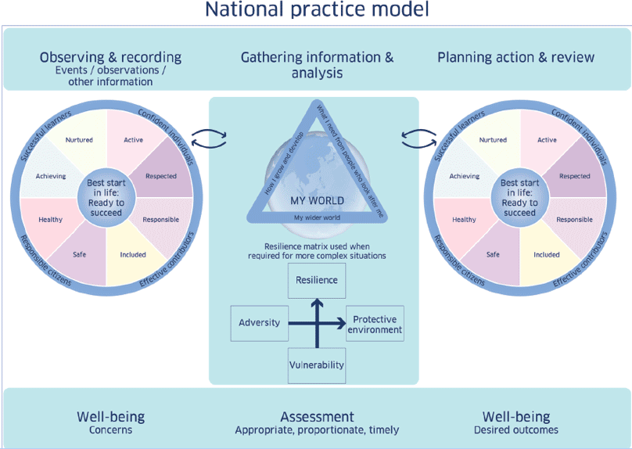
The importance of the National
Practice Model

Slide 10
5 Key Questions
What is getting in the way of this child or young person’s wellbeing?
Do I have all the information I need to help this child or young person?
What can I do now to help this child or young person?
What can my agency do to help this child or young person?
What additional help, if any, may be needed from others?

Slide 11
The Named Person service and the Named Person
The Named Person service (education) is the Local Authority
The Named Person carries out the functions on behalf of the service provider – the Local Authority
The responsibility for the exercise of these functions lies with the service provider and not the individual
The Act does not impose any additional legal responsibilities on any individual who is carrying out the Named Person functions.
The Named Person will exercise these functions in the context of supporting the wellbeing of the child/young person in their professional role

Slide 12
The Named Person functions
The Named Person functions three main categories
Advise inform or support the child or young person or parent
Help the child or young person or a parent to access a service or support
Discuss or raise a matter about a child or young person with a service provider or relevant authority

Slide 13
GIRFEC and HSCP
Support
Challenge
Expectation
Notes:
Since the Children (Scotland) Act 1995 – the most defining ACT 2014 for Children’s Services
Support - changes how we do things (systems)
Challenge – what we do (culture)
Expectation – What works (how we all work together to improve outcomes) (practice)

Slide 14
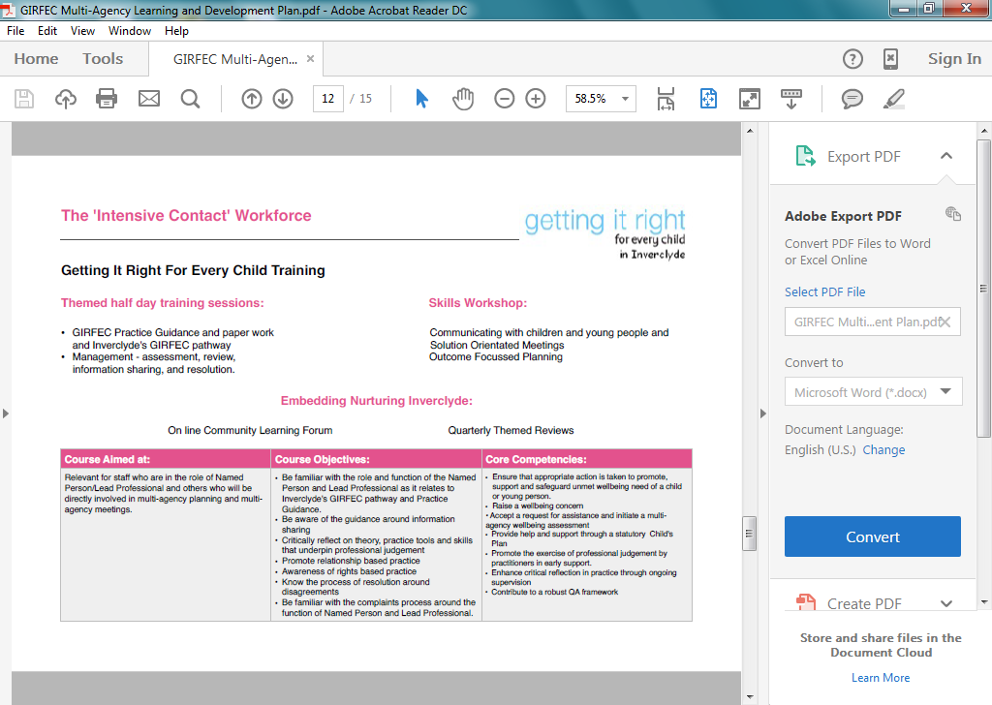
Multi-Agency Training Plan
Notes:
A further step to operationalising Nurturing Inverclyde – early help and effectiveness of help (Munro,2011) through us all having a clear planning processes

Slide 15
Questions?
Comments?
(Post-its)

Slide 16
Staged Assessment and Intervention – how to manage the transition to the GIRFEC Pathways
Group Activity

Slide 17
What else do you need to
support you as Named
Person?
Write on post-it notes any suggestions that you have and put on the flipchart before you leave

Slide 18
