Slide 1

The Inverclyde GIRFEC Pathways
Notes:
This document contains an overview of the Inverclyde GIRFEC Pathways Model (May 2016). This can be used as a reference point and training resource for the Inverclyde GIRFEC Pathways.

Slide 2
GIRFEC Pathways Strategy Group
Angela Edwards/Ruth Binks (Heads of Service)
Sheena Beaton, Norman Greenshields, Linda Wilkie (QIO Team)
Kate Watson, Margaret Nash, Paula Dudgeon, Laurence Reilly, Michelle Keith (Ed Psych Services)
Liz Ruddy, Graeme Marshall, Simone McCredie (Primary Ed.)
Alan Dick, Gillian Macartney, Fiona Craig (Secondary Ed.)

Slide 3
Home Page
Pathways Definitions
Wellbeing Assessment Pathway Examples
Named Person/Lead Professional Definition
Wellbeing Assessment Example
Single Agency Led Plan Example
My World Triangle Assessment Example
Notes:
This PowerPoint contains a number of links to show definitions of key terms.

Slide 4

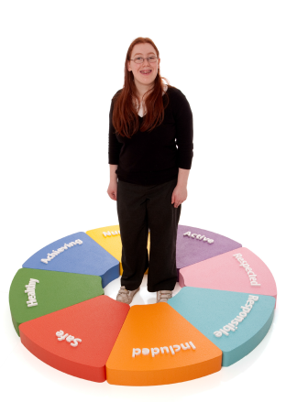



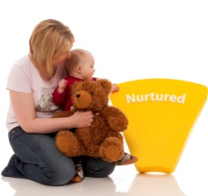

The Inverclyde GIRFEC Pathways
Universal
Enhanced Universal
Enhanced Collaborative
Collaborative
Enhanced Universal
Enhanced Collaborative
Collaborative
Universal
Notes:
The chevron symbols, shown between the triangles, represent the GIRFEC Pathways all Inverclyde Children and Young People follow from Birth to the World of Work. We have condensed the length of these Pathways into a small number of steps from left to right for the purpose of fitting the diagram into this slide, but in reality we can understand that there are many steps between Birth and the World of Work.

Slide 5
The Inverclyde GIRFEC Pathways
The purpose of the Inverclyde GIRFEC Pathways policy is to provide a model for the Named Person (in some cases, in partnership with the Lead Professional) to assist the practical process of ensuring Wellbeing for every child.
It is the process by which we Get It Right For Every Child where there is a clear understanding that the ‘It’ represents the service required to support a Child’s Wellbeing
Notes:
The GP Strategy Group, in consultation with our partners in other areas of the council, have created this model so that it is clear enough to assist the practical process of meeting children’s needs without becoming a barrier to supporting children’s wellbeing. Hopefully, this model addresses some of the key concerns which surround the Staged Assessment and Intervention process which it will replace. Primarily it will attempt to clarify our thinking around GIRFEC and enhance and refine our language to help us interpret the legislation on which it is based.

Slide 6
The Inverclyde GIRFEC Pathways
There are four Inverclyde GIRFEC Pathways: Universal, Enhanced Universal, Collaborative and Enhanced Collaborative.
All children and young people in Inverclyde are on a GIRFEC Pathway at all times.
There is a presumption that children will follow the Universal Pathway unless an unmet need is impacting on an individual’s Wellbeing Outcomes.
Notes:
Before we offer some definitions for each of these 4 Pathways, we estimate that around 80% of children and young people will be on and follow a Universal Pathway. Around 20% of children and young people will spread across one of the other GIRFEC Pathways.

Slide 7
The Inverclyde GIRFEC Pathways
The voice of the Child and their Family is a central feature of The GIRFEC Pathways.
Culture and Ethos: Services should work to create the type of relationships which ensure children and their families feel confident about raising wellbeing concerns to someone within the Named Person Service and in engaging in the process of addressing these concerns.
Informed Consent: Services should establish an agreed standard and format to gain consent from children and their families, when it is in the best interest of the child, to share information with another professional.

Slide 8
The Inverclyde GIRFEC Pathways
Active Participation: Professional are expected to encourage the participation of children and their families at every step along the GIRFEC Pathways. Indeed, the Inverclyde Wellbeing Assessment tools specifically require the views of the child and parent to be formally recorded as part of the process.
Understanding the Child’s Point of View: Professionals should use age/stage appropriate resources, such as Nurturing Me, to help determine the child’s views of their network of support and the process of assessment, planning and review.

Slide 9

Universal Pathway
The Universal Pathway encompasses the CfE entitlement of personal support for all pupils. The promotion of Wellbeing is embedded in the culture and ethos of the establishment and is evident in its policies, systems and practice. The Universal Service is the generic ways in which establishment staff meet the wide continuum of wellbeing needs of children through the normal day-to-day running of the school. It is a dynamic, evolving provision, responsive to strategic improvement and inevitable changes in resources.
Notes:
No one is suggesting that this task, as explained in this definition, is easy or simple, but we would agree that it’s the main part of what we do. It could be argued that the key function of those staff based in our establishments is to maintain the ‘width’ of our Universal Pathway to meet as many children’s needs as we can within the normal running of things.

Slide 10
Enhanced Universal Pathway
The Enhanced Universal Pathway is followed when a child is assessed as needing something different from, or significantly more of, what is normally provided within the Universal Service. When the unmet needs of a child are deemed, in the judgement of the Named Person, to be impacting on their wellbeing outcomes, a single agency wellbeing assessment may be initiated to analyse those unmet needs. If this assessment informs the development of a single agency led plan, outcomes and interventions are agreed within the scope of the Enhanced Service.
Notes:
It is vital to emphasise the importance of the assessment phase as a distinct part of the pathway. There is no shortcut to ‘Plan’ as this may lead to a plan that is not based on an accurate analysis of the information we (collectively) have about a child’s wellbeing. It is also important to understand that we are looking for evidence that unmet needs are negatively impacting on a child’s wellbeing.

Slide 11
Collaborative Pathway
The Collaborative Pathway is followed when a child is assessed with needs that cannot be met by the Single Agency Led Plan alone. When the unmet needs of a child are deemed, in the judgement of the Named Person, to be impacting on their wellbeing outcomes, a My World Triangle Assessment may be initiated to analyse those unmet needs. If this assessment informs the development of a multi-agency plan, outcomes and interventions requiring the collaboration of more than one service are agreed. The most appropriate Lead Professional is identified to oversee this plan.
Notes:
It is important to point out that every assessment culminates in a professional judgement as to what happens next…i.e which pathway is followed.

Slide 12
Enhanced Collaborative Pathway
The Enhanced Collaborative Pathway is followed when a Statutory Child’s Plan is required to ensure the outcomes are met as a result of the interventions which are delivered.
Notes:
This Pathway doesn’t necessarily indicate an increased level of educational involvement as there may be occasions where a Statutory Child’s Plan may only contain a relatively simple intervention on the part of staff within educational services.

Slide 13
The Inverclyde GIRFEC Pathways
There are features of the Universal Pathway which are consistent across all Inverclyde Educational Establishments…
…and there are features of the Universal Pathway which may be specific to a particular Educational Establishment as a result of school policy, experience or expertise.
This means that Transitions are critical events on a child or young person’s Pathway to ensure Wellbeing Assessments and Plans are effective in maintaining Wellbeing.
Notes:
To help understand some of the key concepts we would need to be clear that the boundaries between Universal and Enhanced Universal Pathways may differ from one setting to the next. Heads of Establishments are the experts on the nature and ‘width’ of the Universal Pathway and Enhanced Universal Pathway in their particular establishment.
For example, where a child moves from an establishment with high level of experience and expertise around meeting the needs of a child with English as an Additional Language as part of their Universal Service to an establishment with very little of either, an assessment may result in the development of a Single Agency Led Plan. Likewise an establishment with high numbers of children with children who experience, for example, social and emotional difficulties or specific literacy difficulties may have developed their universal service to meet the vast majority of these children’s needs within their universal pathway. In another setting, a child with that profile may follow an enhanced universal pathway because something which is significantly different from the norm may be required to meet the child’s needs.

Slide 14
The Inverclyde GIRFEC Pathways
Each Educational Establishment will have ways in which
they promote Wellbeing within their Universal Service and identify and record when a child’s Wellbeing is being affected by unmet needs.
The way in which this is identified, recorded and passed to the Named Person may differ from establishment to establishment, but the Single and Multi Agency Wellbeing Assessment is standardised across Inverclyde.
Notes:
The practice of identifying and passing on concerns may be different from one setting to the next.
The record of the assessment process is the same across all Inverclyde establishments.

Slide 15
The Inverclyde GIRFEC Pathways
Most of the time, a concern about a child’s wellbeing is responded to within the Universal Pathway.
The other Inverclyde GIRFEC pathways exist to allow a consistent model for achieving positive wellbeing outcomes when concerns about a child’s wellbeing are becoming increasingly complex, immediate, intense or require the intervention of other agencies.
Notes:
Responding to concerns is a significant part of our daily work. It is the professional judgement of staff, based on knowledge of the child and their circumstances, which ensures that a proportionate response occurs.

Slide 16
Inverclyde GIRFEC Pathways
Example 1: in which a Wellbeing Assessment helps to establish the features of the Universal Service a child requires.
Enhanced Collaborative
Single Agency Wellbeing Assessment
Universal
Wellbeing Concern passed to Named Person
Collaborative
Enhanced Universal
Continue Universal Personal Support
Notes:
So what are the things we must consider that helps us to understand how a child’s pathway changes?
Remember: the vast majority of wellbeing concerns are responded to ‘in the moment’ with no need for it to be passed to the Named Person.
Indeed, most of the concerns passed to the Named Person may ‘only’ be responded to in a normal and relatively informal way.
On some occasions, the Named Person may feel that a Single Agency Wellbeing Assessment may help to identify the impact of unmet needs.
The process of the Single Agency Assessment in itself may be enough to make normal everyday adjustments to meet the child’s needs more effectively.
The Single Agency Assessment may be compiled as part of a single meeting in one sitting or may take place over a longer period of time as a result of a variety of discussions and other information gathering opportunities.

Slide 17
Inverclyde GIRFEC Pathways
Example 2 : in which a Wellbeing Assessment helps to establish the need for a Single Agency Led Plan.
Enhanced Collaborative
Single Agency Wellbeing Assessment
Universal
Wellbeing Concern passed to Named Person
Collaborative
Enhanced Universal
Establish Single Agency led plan
Review Single Agency Plan
Notes:
On this occasion, the analysis of the Single Agency Wellbeing Assessment by the Named Person has resulted in the creation of a Single Agency Led Plan. Remember, this means that the child has been assessed as needing something different from, or significantly more of, what is normally provided within the Universal Service. The Single Agency Led Plan provides a clear understanding of what this enhanced service looks like in practical terms and the outcomes this enhanced provision aims to secure for the child. Again, elements of the Single Agency Led Plan may be formulated first as these interventions may be easier to define and initiate whilst others may take some reorganisation or investigation.

Slide 18
Inverclyde GIRFEC Pathways
Example 3 : in which a Wellbeing Assessment helps to establish the need for Multi Agency Child’s Plan.
Enhanced Collaborative
Single Agency Wellbeing Assessment
Universal
Wellbeing Concern passed to Named Person
Collaborative
Enhanced Universal
Establish Single Agency led plan
Review Single Agency led plan
Create Multi Agency Plan
Review Multi Agency Plan
My World Triangle Assessment
Notes:
On this occasion, the review of the Single Agency Led Plan has shown that this plan has been unable to meet the needs of the child and the Named Person has initiated a deeper form of assessment involving representatives from other agencies. In this example, the decision is made to create a Multi Agency Plan and Lead Professional identified.
Remember, there may also be occasions where the My World Triangle (Multi Agency Assessment) process is enough in itself and the Single Agency Led Plan remains in place (perhaps with some adjustments).

Slide 19
Inverclyde GIRFEC Pathways
Example 4: in which a Wellbeing Assessment helps to establish the need for further assessment leading to a Multi Agency Plan.
Enhanced Collaborative
Single Agency Wellbeing Assessment
Universal
Wellbeing Concern passed to Named Person
Collaborative
Enhanced Universal
Continue Universal Personal Support
Wellbeing Concern passed to Named Person
Single Agency Wellbeing Assessment
Create Multi Agency Plan
Review Multi Agency Plan
My World Triangle Assessment
Notes:
There may be occasions, where circumstances change very quickly and a Single Agency Led Plan is bypassed…but the Assessment Phase is NEVER bypassed.

Slide 20
Inverclyde GIRFEC Pathways
Enhanced Universal
Collaborative
Enhanced Collaborative
Universal
Enhanced Universal
Collaborative
Enhanced Collaborative
Universal
Notes:
The following four slides can be used to illustrate the shape of a particular Pathway. For example, clicking on each of the steps from left to right on the Universal Pathway would illustrate an example of when a child remains on the universal pathway over a period of time. A further example, would be created by clicking on the first step on the Universal Pathway, then the middle 5 steps on the Enhanced Universal Pathway and then the final step on the Universal Pathway to show an example of a child who follows an Enhanced Universal Pathway for a period of time and then has their needs met within the normal service again.

Slide 21
Inverclyde GIRFEC Pathways
Enhanced Universal
Collaborative
Enhanced Collaborative
Universal
Enhanced Universal
Collaborative
Enhanced Collaborative
Universal

Slide 22
Inverclyde GIRFEC Pathways
Enhanced Universal
Collaborative
Enhanced Collaborative
Universal
Enhanced Universal
Collaborative
Enhanced Collaborative
Universal

Slide 23
Inverclyde GIRFEC Pathways
Enhanced Universal
Collaborative
Enhanced Collaborative
Universal
Enhanced Universal
Collaborative
Enhanced Collaborative
Universal

Slide 24
Key Features
Named Person
The professional within one of the universal services of maternity, public health, primary or secondary education who is responsible for children and young people’s wellbeing at different stages of their lives
What I Think Tool
Is a tool which supports professionals to encourage children and young people to express and record their own views about wellbeing, what help they might need and what they would like to change
Wellbeing Wheel
Represents the eight indicators of wellbeing which are the desired outcomes for every child in Scotland. Each aspect of children and young people’s wellbeing should be considered if professionals have any concern
Discussion with child/young person
Children and young people should be consistently involved in the decisions which affect their lives and professionals are expected to encourage participation at every stage in any process of assessment, planning and review
Resilience Matrix
The tool which is used to analyse all the available information to identify the priority issues in a child or young person’s life and what needs to change. It allows the balance between adversity and protective factors and between resilience and vulnerability to be identified
Informed Consent
An agreed standard and format used to gain permission from children and families when it is in the best interest of a child or young person to share information with another professional
The Integrated Assessment
A format used when agencies need to integrate their working practice to develop a child’s wellbeing. It builds from Single Agency Assessments and Plans using the My World Triangle and Resilience Matrix
The Child/Young Person’s Network of Support
This is the term used to describe the group of practitioners who are contributing to improving a child/young person’s wellbeing at any given time. It could be a large group from different agencies or two or more practitioners from the same agency
Single Agency led plan
This plan is used within one agency and follows on from any Single Agency Assessments. It identifies the desired outcomes or positive changes needed to a child’s wellbeing and the actions necessary to achieve them. The Single Agency Plan will also contain timescales and who is responsible for achieving them
Multi Agency Plan
The multi agency plan is used when agencies need to integrate their working practice to develop a child or young person’s wellbeing. It follows on from the Integrated Assessment and specifics the desired outcomes or positive changes and the actions necessary to achieve them. It details exactly what will be done by whom and by when to develop a child or young person’s wellbeing
Single Agency Chronology
An agreed format used within one agency to provide a summary of positive and negative significant events for the child/young person. This tool helps to identify patterns and trends in children and young people’s lives and will contribute to ongoing assessment, planning and review
My World Triangle
The My World Triangle Assessment provides a common structure to think about the child’s whole world when one agency needs a detailed picture of a child/young person’s life. It is used to gather and structure relevant information into a mental map of all the strengths and pressures affecting a child and family to identify the most appropriate response
A Request for Assistance
An agreed format to ask for help for a child/young person no matter what they need from health, education, social work, housing, adult services or the voluntary sector. The aim is to replace all existing referral forms we currently use with one standard format
Lead Professional
The professional who agrees to coordinate and review the Child’s Plan when more than one agency is working together
Integrated Chronology
An agreed format which brings together information from all Single Agency Chronologies into one single document, providing a summary of positive and negative significant events. It can be regularly updated and discussed as part of ongoing assessment and planning to make sure that everything possible is being done to develop the child/young person’s wellbeing

Slide 25
Named Person
The professional identified within one of the universal services of public health, primary or secondary education whose service is responsible for children and young people’s wellbeing at different stages of their lives

Slide 26
Lead Professional
The professional who agrees to coordinate and review the Child’s Plan when more than one agency is working together

Slide 27
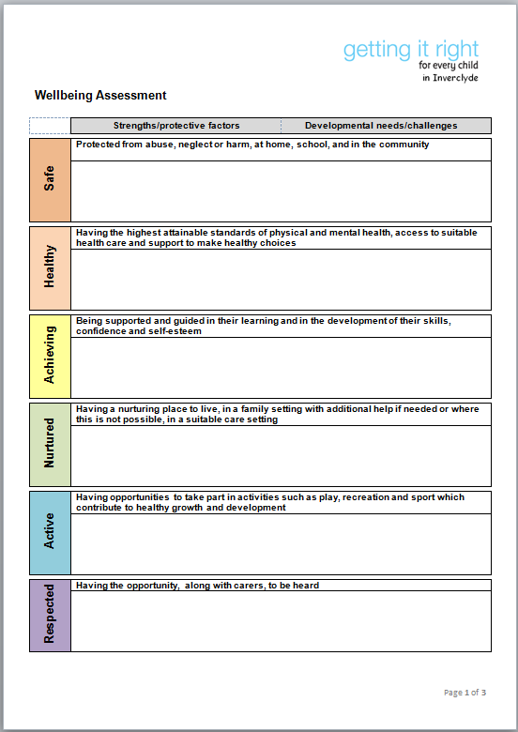
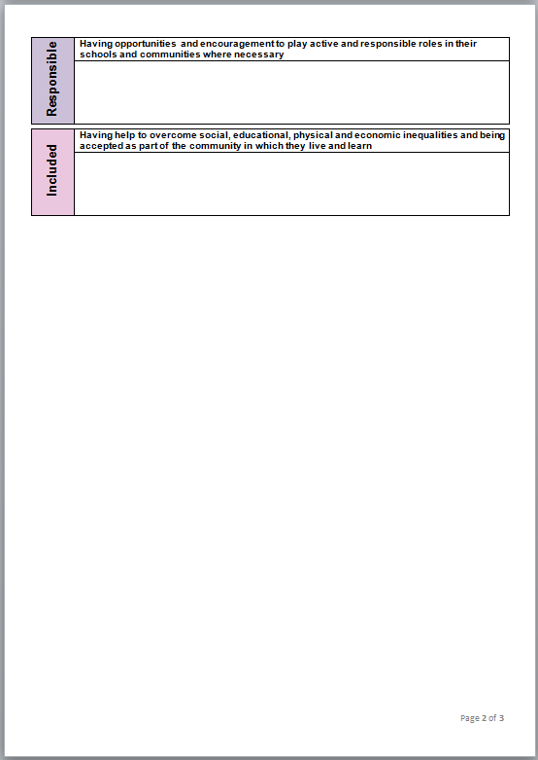
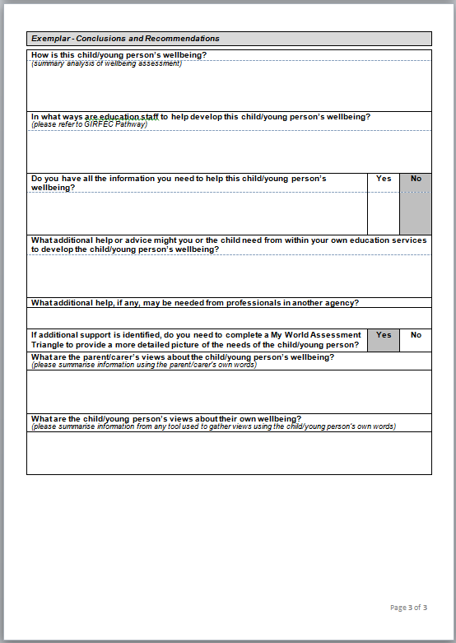
Wellbeing Assessment
This is the format for recording a Single Agency Wellbeing Assessment.
This is completed by the Named Person or someone delegated to do so by the Named Person. It might be completed during a single meeting or over a period of time as information is gathered and checked for reliability.

Slide 28
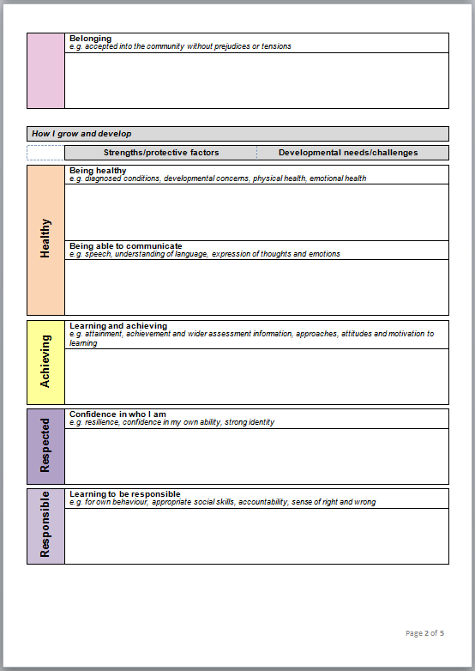
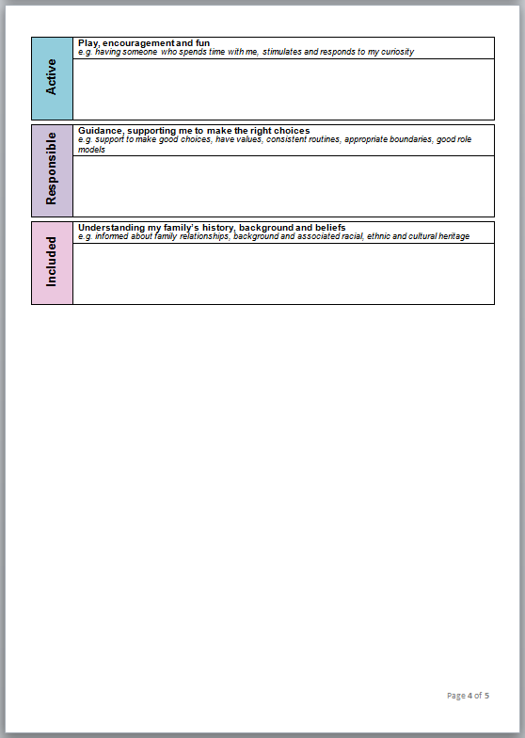
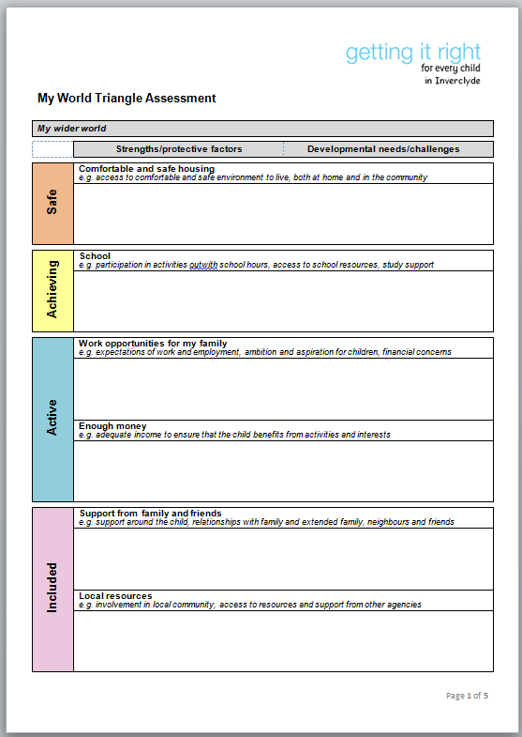
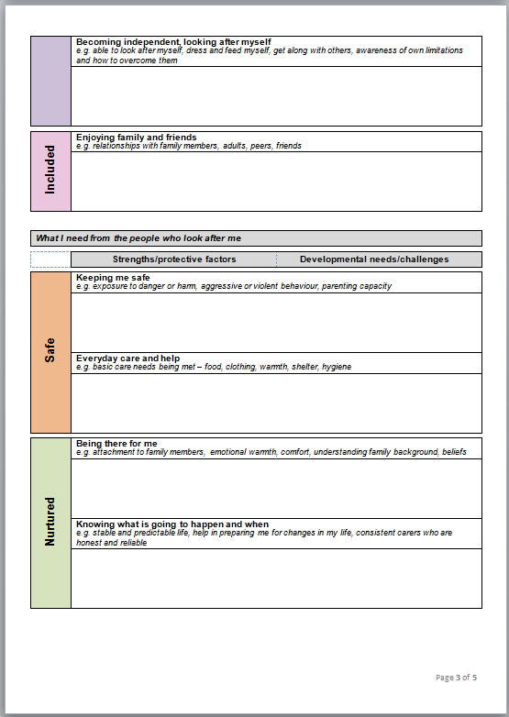
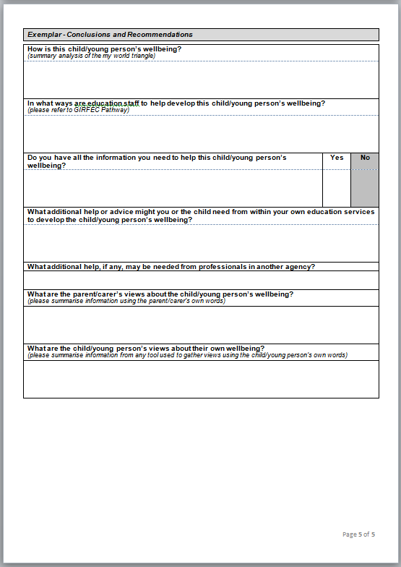
My World Triangle Assessment
My World Triangle
The My World Triangle Assessment provides a common structure to think about the child’s whole world when one agency needs a detailed picture of a child/young person’s life. It is used to gather and structure relevant information into a mental map of all the strengths and pressures affecting a child and family to identify the most appropriate response

Slide 29
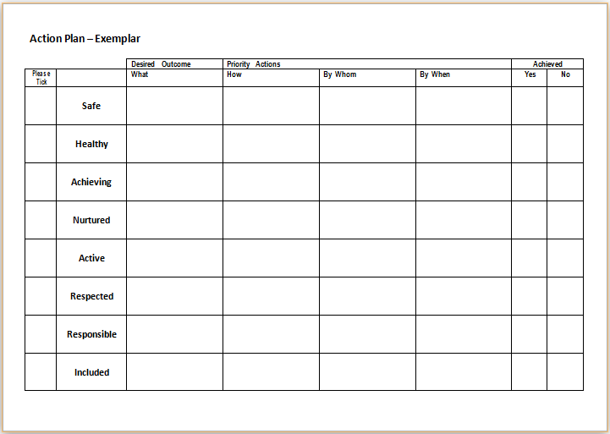
Action Plan

Slide 30
Single Agency led plan
This plan is used within one agency and follows on from any Single Agency Assessments. It identifies the desired outcomes or positive changes needed to a child’s wellbeing and the actions necessary to achieve them. The Single Agency Plan will also contain timescales and who is responsible for achieving them

Slide 31
Multi Agency Plan
The multi agency plan is used when agencies need to integrate their working practice to develop a child or young person’s wellbeing. It follows on from the Integrated Assessment and specifics the desired outcomes or positive changes and the actions necessary to achieve them. It details exactly what will be done by whom and by when to develop a child or young person’s wellbeing

Slide 32
Single Agency Chronology
An agreed format used within one agency to provide a summary of positive and negative significant events for the child/young person. This tool helps to identify patterns and trends in children and young people’s lives and will contribute to ongoing assessment, planning and review

Slide 33
Integrated Chronology
An agreed format which brings together information from all Single Agency Chronologies into one single document, providing a summary of positive and negative significant events. It can be regularly updated and discussed as part of ongoing assessment and planning to make sure that everything possible is being done to develop the child/young person’s wellbeing

Slide 34
A Request for Assistance
An agreed format to ask for help for a child/young person no matter what they need from health, education, social work, housing, adult services or the voluntary sector. The aim is to replace all existing referral forms we currently use with one standard format

